Slide 1
P4: specifying data planes http://P4.org
Intel – Hillsboro, OR July 10, 2018
Mihai Budiu
VMware Research Group

Slide 2
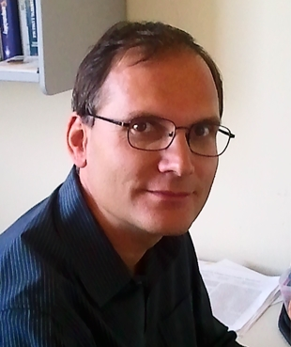
My Background
Ph.D. from CMU (computer architecture, compilers)
Microsoft Research (security, big data, machine learning)
Barefoot Networks (P4 design and implementation)
VMware Research (P4, SDNs, big data)
Note: I am not a networking person

Slide 3
My involvement with P4
Hired at to work on the design and implementation of P4
In Barefoot led the group that created the first P4₁₆ draft document
Started (with Chris Dodd) the C++ reference compiler implementation
Main contributor to the open-source P4 compiler front-end, mid-end and several back-ends
Pushed P4₁₆ through standardization process
Currently co-chair of the P4 language design working group

Slide 4
What I can talk about today
P4₁₆ programming language
Language design
Language/architecture separation
Portability vs. extensibility
P4₁₆ reference compiler architecture
How to extend the compiler for a new target
Compiling P4->eBPF
Compiling to eBPF (packet filters)
Compiling to XDP (packet switching)
Comparing P4 and eBPF
These are organized as 3 separate PPTX presentations

Slide 5
What I don’t plan to cover
P4₁₄ (the old version of P4)
Run the P4 tutorials (given at P4 developer days)
Demonstrate P4-related tools (compilers, simulators, IDEs)
The P4 control-plane API (P4Runtime)
The P4 Portable Switch Architecture
Various applications written in P4

Slide 6
Presentation outline
P4 & Programmable networks
Why should you care?
An introduction to P4₁₆
P4 limitations
Conclusions

Slide 7
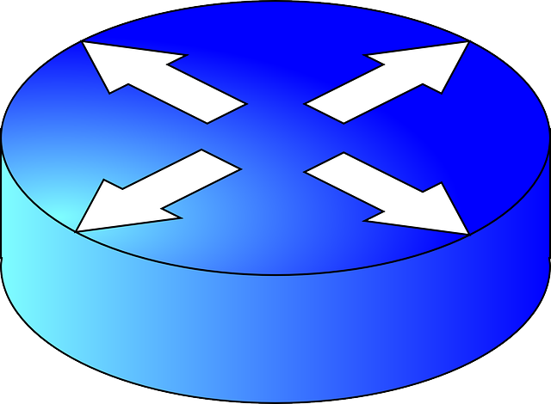
Networking 101
Data packets
switches/ routers

Slide 8
Switch Control and Data Planes
Switch architecture
Control plane
packets
Data plane
Interfaces

Slide 9
Traditional switch architecture
Control-plane CPU
Control plane
Table management
Data plane
Switch ASIC
Look-up tables (policies)

Slide 10
Software-Defined Networking
Policies/signaling
Controller
Dumb control plane
Data plane

Slide 11
The P4 world
Upload program
Policies/signaling
Dumb control plane
Programmable data plane
SW: P4

Slide 12
Not just for switches!
Programmable switches
FPGA switches
Programmable network cards
Software switches
Hypervisor switches
You name it…
Control plane
Programmable data plane
SW: P4

Slide 13
How is this possible?
Hello
?
Datacenter
Most useful if you have your own network playground

Slide 14
Data-planes
From now on in this presentation we only talk about the data-plane
We expect that SDN will continue to evolve the control-plane
Control plane
Data plane

Slide 15
WHY SHOULD YOU CARE?

Slide 16
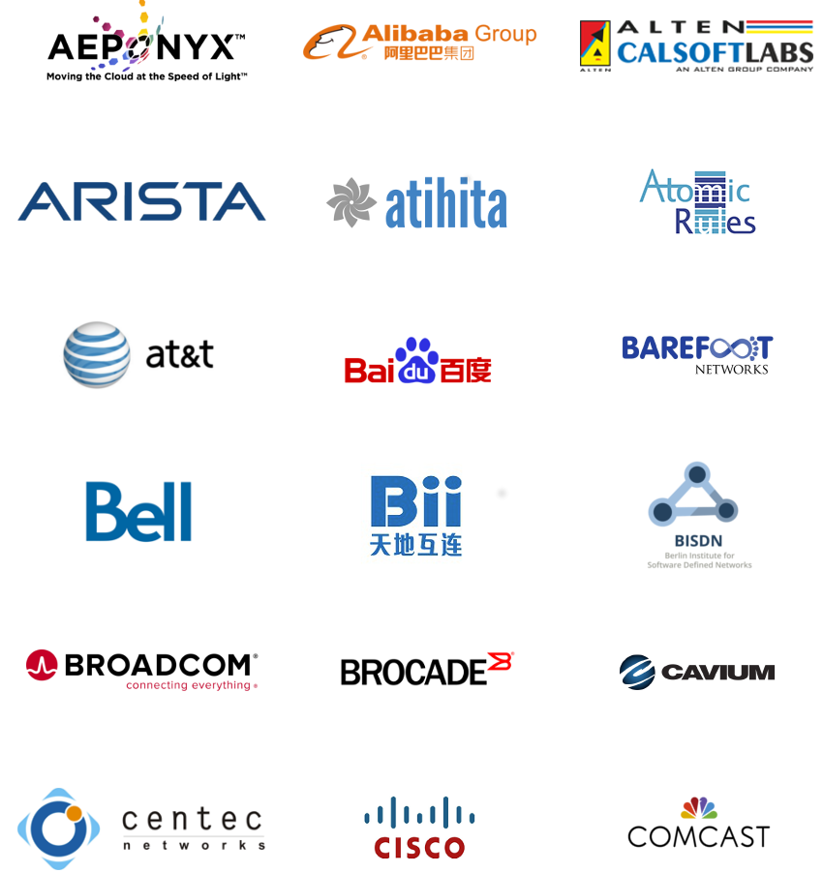
P4.org Consortium
Carriers, cloud operators, chip cos, networking, systems, universities, start-ups

Slide 17
Isn’t Open-Flow Enough?
Open-Flow version
Open-flow has never been enough: it keeps changing to describe new protocols
Very fragmented

Slide 18
Protocols = programs
VxLAN: 175 lines of P4
Took 4 years from proposal to wide availability
NVGRE: 183 lines of P4
M. Shahbaz, S. Choi, B. Pfaff, C. Kim, N. Feamster, N. McKeown, J. Rexford, PISCES: A Programmable, Protocol-Independent Software Switch SIGCOMM 2016
40 times reduction in the size of the OvS parser
Much easier to add new protocols
Same performance

Slide 19
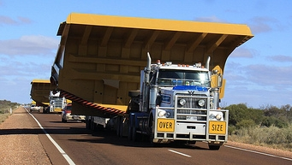
Use only what you need
IETF has issued thousands of RFCs
Switch RAM and CPU is very expensive
Network operators can remove protocols
Simpler troubleshooting

Slide 20
Network monitoring
measurements
(custom headers)
Monitoring
agent
In-Band Network Telemetry (INT)
Improving Network Monitoring and Management with Programmable Data Planes
By Mukesh Hira & LJ Wobker

Slide 21
Optimize your network
Push application functionality in the network
High speed
Paxos Made Switch-y
Huynh Tu Dang, Marco Canini, Fernando Pedone, Robert Soulé
CCR April 2016

Slide 22
Network = software
Use software engineering principles and tools
Upgrade your network at any time
Protocols = intellectual property

Slide 23
AN INTRODUCTION to P4₁₆

Slide 24
Language evolution
P4: Programming Protocol-Independent Packet Processors
Pat Bosshart, Dan Daly, Glen Gibb, Martin Izzard, Nick McKeown, Jennifer Rexford, Cole Schlesinger, Dan Talayco, Amin Vahdat, George Varghese, David Walker ACM SIGCOMM Computer Communications Review (CCR). Volume 44, Issue #3 (July 2014)
P4 v1.0 spec, reference implementation and tools released in Spring 2015 (mostly by Barefoot Networks), Apache 2 license, http://github.com/p4lang.
P4₁₆ spec, draft reference implementation and tools released in December 2016; spec finalized May 2017; v1.1 in June 2018 http://github.com/p4lang/p4-spec

Slide 25
P4 Community
http://github.com/p4lang
http://p4.org
Free membership!
Mailing lists
Workshops
P4 developer days
Academic papers (SIGCOMM, SOSR)

Slide 26
P4 working groups
Language design: evolves P4
Control-plane API: defines API between control-plane and P4 program (P4Runtime)
Applications: defines interoperable applications (e.g. In-band Network Telemetry)
Architecture (Portable Switch Architecture): standardizes portable architecture models
Education

Slide 27
Available Software Tools
Compilers for various back-ends
Netronome chip, Barefoot chip, eBPF, Xilinx FPGA
(open-source and proprietary)
Multiple control-plane implementations
SAI, OpenFlow, P4Runtime
Simulators
Testing tools
Sample P4 programs
IntelliJ plugin IDE, editor modes
Tutorials

Slide 28
P4 software workflow
User-supplied
Control-plane
P4 program
P4 compiler
API
LOAD
API
control
signals
P4 architecture
model
Dataplane runtime
Data plane
LOAD
Tables
extern objects
target
Manufacturer supplied

Slide 29
P4₁₆
Most recent revision of P4
C-like syntax; strongly typed
No loops, pointers, recursion, dynamic allocation
Spec: http://github.com/p4lang/p4-spec
Reference compiler implementation (Apache 2 license): http://github.com/p4lang/p4c

Slide 30
P4₁₆ Language Overview
Suitable for L2 & 3
High-level, type, memory-safe (no pointers)
Bounded execution (no loops)
Statically allocated (no malloc, no recursion)
Sub-languages:
Parsing headers
Packet header rewriting
Target architecture description

Slide 31
P4₁₆ data plane model
Programmable blocks
Data plane
P4
P4
P4
Fixed function
Interfaces

Slide 32
Example packet processing pipeline
Programmable
parser
eth
vlan
ipv4
Headers
Payload
Packet (byte[])
Programmable
match-action
units
eth
ipv4
port
Queueing/
switching
mtag
err
bcast
Metadata
Not programmable
Headers
eth
mtag
ipv4
Programmable
reassembly
Packet

Slide 33
Language elements
Programmable
parser
State-machine; bitfield extraction
Programmable
match-action
units
Table lookup; bitfield manipulation; control flow
Programmable
reassembly
Bitfield packing
Data-types
Bitstrings, headers, structures, arrays
user
Target
description
target
Interfaces of programmable blocks
External libraries
Support for custom accelerators

Slide 34
Basic data types
bit<N>, int<N>
e.g., bit<128>, int<1024>
int is two’s complement
varbit<13>
Container up to specified size; dynamic size is shorter
Only operation is copying
bool
enum, error, match_kind
error { PacketTooShort, ParseError }
error.PacketTooShort
Only string constants supported
typedef

Slide 35
Structures, headers
typedef bit<32> IPv4Address;
header IPv4_h { bit<4> version; bit<4> ihl; bit<8> tos; bit<16> totalLen; bit<16> identification; bit<3> flags; bit<13> fragOffset; bit<8> ttl; bit<8> protocol; bit<16> hdrChecksum; IPv4Address srcAddr; IPv4Address dstAddr; }
// List of all recognized headers struct Parsed_packet { Ethernet_h ethernet; IPv4_h ip; }
header = struct + valid bit

Slide 36
Other derived types
Array of headers
H[6] arr;
Fixed size
Unions of headers
header_union IP { ipv4 v4header; ipv6 v6header; }
Tuples
tuple<bit<32>, bit<16>>
set<tuple<bit<32>, bit<16>> - implicit only
No recursive types

Slide 37
Expression language
Standard arithmetic/logic on arbitrary bitstrings
But no funky undefined cases like in C
2s complement for signed values
No division/modulo
Bit-slicing, bit concatenation
Integers are not Booleans
No implicit casts

Slide 38
Extern objects
Model hardware accelerators or…
…behaviors not expressible in P4
extern Register<T> { Register(bit<32> size); T read(in bit<32> index); void write(in bit<32> index, in T value); }
Register<bit<32>>(1024) reg;
Method calls using copy-in, copy-out
Like Java interfaces
Generic type
constructor
instantiation

Slide 39
Packets = byte streams
extern packet_in {
void extract<T>(out T headerLvalue); void extract<T>(out T varSizeHdr, in bit<32> varFieldSizeBits); T lookahead<T>(); bit<32> length(); void advance(in bit<32> bits); }
extern packet_out { void emit<T>(in T hdr); void emit<T>(in bool condition, in T data); }

Slide 40
Parsing = State machines
dst
src
type
IP header
IP payload
ethernet header
parser Parser(packet_in b, out Parsed_packet p) { state start { b.extract(p.ethernet); transition select(p.ethernet.type) { 0x0800: parse_ipv4; default: reject; } }
state parse_ipv4 { b.extract(p.ip); transition accept; } }
start
parse_ipv4
accept
reject
Parser states can contain cycles => loops bounded by packet size

Slide 41
Value Sets
parser p(packet_in pk, out Headers h) { value_set<bit<32>>(4) vs; state start { pk.extract(h); transition select(h.f) { vs: next; default: reject; } … } }
A set of 32-bit values changed dynamically by the control plane.

Slide 42
Actions
~ Objects with a single method.
Straight-line code.
Reside in tables; invoked automatically on table match.
Action data; from control plane
action Set_nhop(IPv4Address ipv4_dest, PortId port) { nextHop = ipv4_dest; outCtrl.outputPort = port; }
class Set_nhop {
IPv4Address ipv4_dest;
PortId port;
void run() {
nextHop = ipv4_dest; outCtrl.outputPort = port
}
}
Java/C++ equivalent code.

Slide 43
Tables
Map<K, Action>
table ipv4_match { key = { headers.ip.dstAddr: exact; } actions = { drop; Set_nhop; } default_action = drop; }
dstAddr | action
0.0.0.0 | drop
10.0.0.1 | Set_nhop(10.4.3.4, 4)
224.0.0.2 | drop
192.168.1.100 | drop
10.0.1.10 | Set_nhop(10.4.2.1, 6)
Populated by the control plane

Slide 44
Table = Match-Action Processing
Control plane
Data
action
code
hit
Key | Action
 | action code & data
action data
Execute
Lookup
headers &
metadata
Action
headers &
metadata
Lookup key
Lookup table
Default action

Slide 45
Control-Flow
Ipv4_match
control Pipe(inout Parsed_packet headers, in InControl inCtrl,// input port out OutControl outCtrl) { // output port IPv4Address nextHop; // local variable
action Drop_action() { … }
action Set_nhop(…) { … }
table ipv4_match() { … }
…
apply { // body of the pipeline ipv4_match.apply(); if (outCtrl.outputPort == DROP_PORT) return;
dmac.apply(nextHop); if (outCtrl.outputPort == DROP_PORT) return;
smac.apply(); } }
dmac
smac

Slide 46
Packet Construction
Convert headers back into a byte stream.
Only valid headers are emitted.
control Deparser(in Parsed_packet p, packet_out b) { apply { b.emit(p.ethernet); b.emit(p.ip); } }

Slide 47
P4 Program structure
#include <core.p4> // core library #include <target.p4> // target description
#include "library.p4" // library functions
#include "user.p4" // user program

Slide 48
Architecture declaration
Provided by the target manufacturer
struct input_metadata { bit<12> inputPort; }
struct output_metadata { bit<12> outputPort; }
parser Parser<H>(packet_in b, out H headers);
control Pipeline<H>(inout H headers, in input_metadata input, out output_metadata output);
control Deparser<H>(in H headers, packet_out p);
package Switch<H>(Parser<H> p, Pipeline<H> p, Deparser<H> d);
H = user-specified header type
Switch
Parser
Pipeline
Deparser

Slide 49
Support for custom “accelerators”
extern bit<32> random();
extern Checksum16 { void clear(); // prepare unit for computation void update<T>(in T data); // add data to checksum void remove<T>(in T data); // remove data from checksum bit<16> get(); // get the checksum for data added }
External function
External object with methods. Methods can be invoked like functions.
Some external objects can be accessed from the control-plane.

Slide 50
Execution model
When a block is invoked (parser, control) it executes to completion on a separate thread
All local variables are thread-local
Only inter-thread communication possible through extern objects and functions
Execution triggered by outside event (e.g., packet arrival)
Actions execute atomically
@atomic annotation

Slide 51
P4 LIMITATIONS

Slide 52
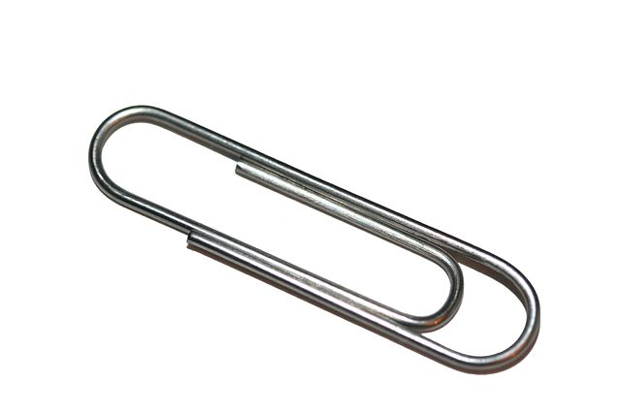
Limitations of P4₁₆
The core P4 language is very small
Highly portable among many targets
But very limited in expressivity
Accelerators can provide additional functionality
May not be portable between different targets
Standard architectures to ensure portability
Portable switch architecture (PSA)
Library of standard accelerators (counters, meters, etc)
No standard smart NIC architecture exists!

Slide 53
What is missing
Floating point
Pointers, references
Data structures, recursive data types
Dynamic memory management
Loops, iterators (except the parser state-machine)
Recursion
Threads
=> Constant work/byte of header

Slide 54
What cannot be done in (pure) P4
Multicast or broadcast
Queueing, scheduling, multiplexing
Payload processing: e.g., encryption
Packet trailers
Persistent state across packets
Communication to control-plane
Inter-packet operations (fragmentation and reassembly)
Packet generation
Timers

Slide 55
How are these done?
Multicast, broadcast, queueing, scheduling, multiplexing
By target device, controlled by P4 metadata
Persistent state across packets (e.g. per-flow state)
External objects: registers, counters, meters
Communication to control-plane
External objects: learning providers
Packet generation
Control-plane, or external objects
TCP-style reassembly, trailers:
Not currently done

Slide 56
Why use P4?
It is a standardized language: you can specify the data-plane precisely
Expressive: express many packet-forwarding policies
High-level, type-safe: compiler-managed abstract resources
Software: treat network devices like software
Killer app: network monitoring

Slide 57
Creating a Programming Language Interface in a place where there wasn’t one.
UPLOAD
Control plane
The P4 Programming- Language Interface
Data plane

Slide 58
References
P4: Programming Protocol-Independent Packet Processors Pat Bosshart, Dan Daly, Glen Gibb, Martin Izzard, Nick McKeown, Jennifer Rexford, Cole Schlesinger, Dan Talayco, Amin Vahdat, George Varghese, David Walker ACM SIGCOMM Computer Communications Review (CCR). Volume 44, Issue #3 (July 2014)
The P4-16 Programming Language Mihai Budiu and Chris Dodd ACM SIGOPS Operating Systems Review, Vol. 51, no 1, August, 2017, pages 5-14
P4-16 open-source compiler source tree: https://github.com/p4lang/p4c
P4-16 language v1.1.0 specification: https://p4.org/p4-spec/docs/P4-16-v1.1.0-draft.pdf
Compiler design full presentation: https://github.com/p4lang/p4c/blob/master/docs/compiler-design.pptx
P4Runtime draft spec: https://p4lang.github.io/p4-spec/docs/P4Runtime-v1.0.0.pdf

Slide 59
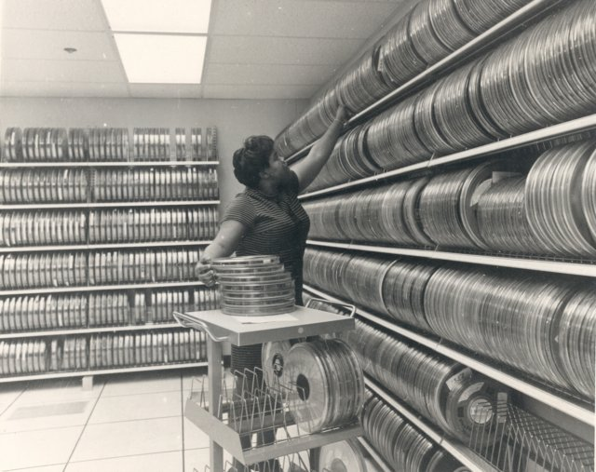
Backup slides

Slide 60
P4₁₆ goals
Strictly more expressive than P4₁₄
Minimally change and simplify P4₁₄
Same building-blocks: headers, parsers, match-action, control
Well-defined semantics for all constructs
Move target-specific constructs from language into libraries
Support a variety of targets (ASICs, NICs, FPGAs, etc.)
Based on well-understood techniques (no need to invent new language constructs)
Strong type system
Support for good software engineering practices

Slide 61
P4₁₄ dataplane model
Control-plane

Slide 62
P4₁₄ to P4₁₆ evolution
P4₁₆
small,
Standardized,
rarely change
P4 v1.0
core.p4
library.p4
Can be large,
manufacturer controlled,
frequent changes
arch.p4

