Slide 1
The P4 language design process
Special Interest Group on Next Generation Networks November 29, 2022
Mihai Budiu
VMware Research Group

Slide 2
My background
Stint as network admin in college
Ph.D. from Carnegie Mellon
Research in computer systems (not networking)
Employed at Barefoot Networks 2014-2016
Started the design process for what became P4₁₆
Started (with Chriss Dodd) the open-source p4c compiler
Since 2018 co-leading the P4 language design working group

Slide 3
P4
A language for programming network switch dataplanes
Note: Software-Defined Networks = programmable control-planes
Introduced in a paper in 2014
Barefoot networks built a P4-programmable switch ASIC
Acquired by Intel in 2019
https://p4.org
https://github.com/p4lang
Many related projects: compiler, APIs, spec, applications, etc.
P4Runtime = the API between the control-plane and the data-plane

Slide 4
Limitations of P4₁₆
The core P4 language is very small
Highly portable among many targets
But very limited in expressivity
Constant work/packet
Accelerators can provide additional functionality
May not be portable between different targets
Standard architectures to ensure portability
Portable switch architecture (PSA)
Libraries of standard accelerators (counters, meters, etc)
Portable NIC (Network Interface Card) Architecture (PNA)

Slide 5
P4 design process
Open to anyone (ONF members)
Using open-source processes
A meeting the first Monday of every month
Zoom link https://p4.org/working-groups/
Time is US-centric (but we can change that)
Spec: https://github.com/p4lang/p4-spec
Working group discussions archived in Google Docs
Relatively small group of regular participants
Most participants are hobbyists!

Slide 6
Why use P4?
It is a standardized language: you can specify the data-plane precisely
Expressive: express many packet-forwarding policies
High-level, type-safe: compiler-managed abstract resources
Software: treat network devices like software
(There are also many uses P4 is not suitable for
e.g., in-network programming)

Slide 7
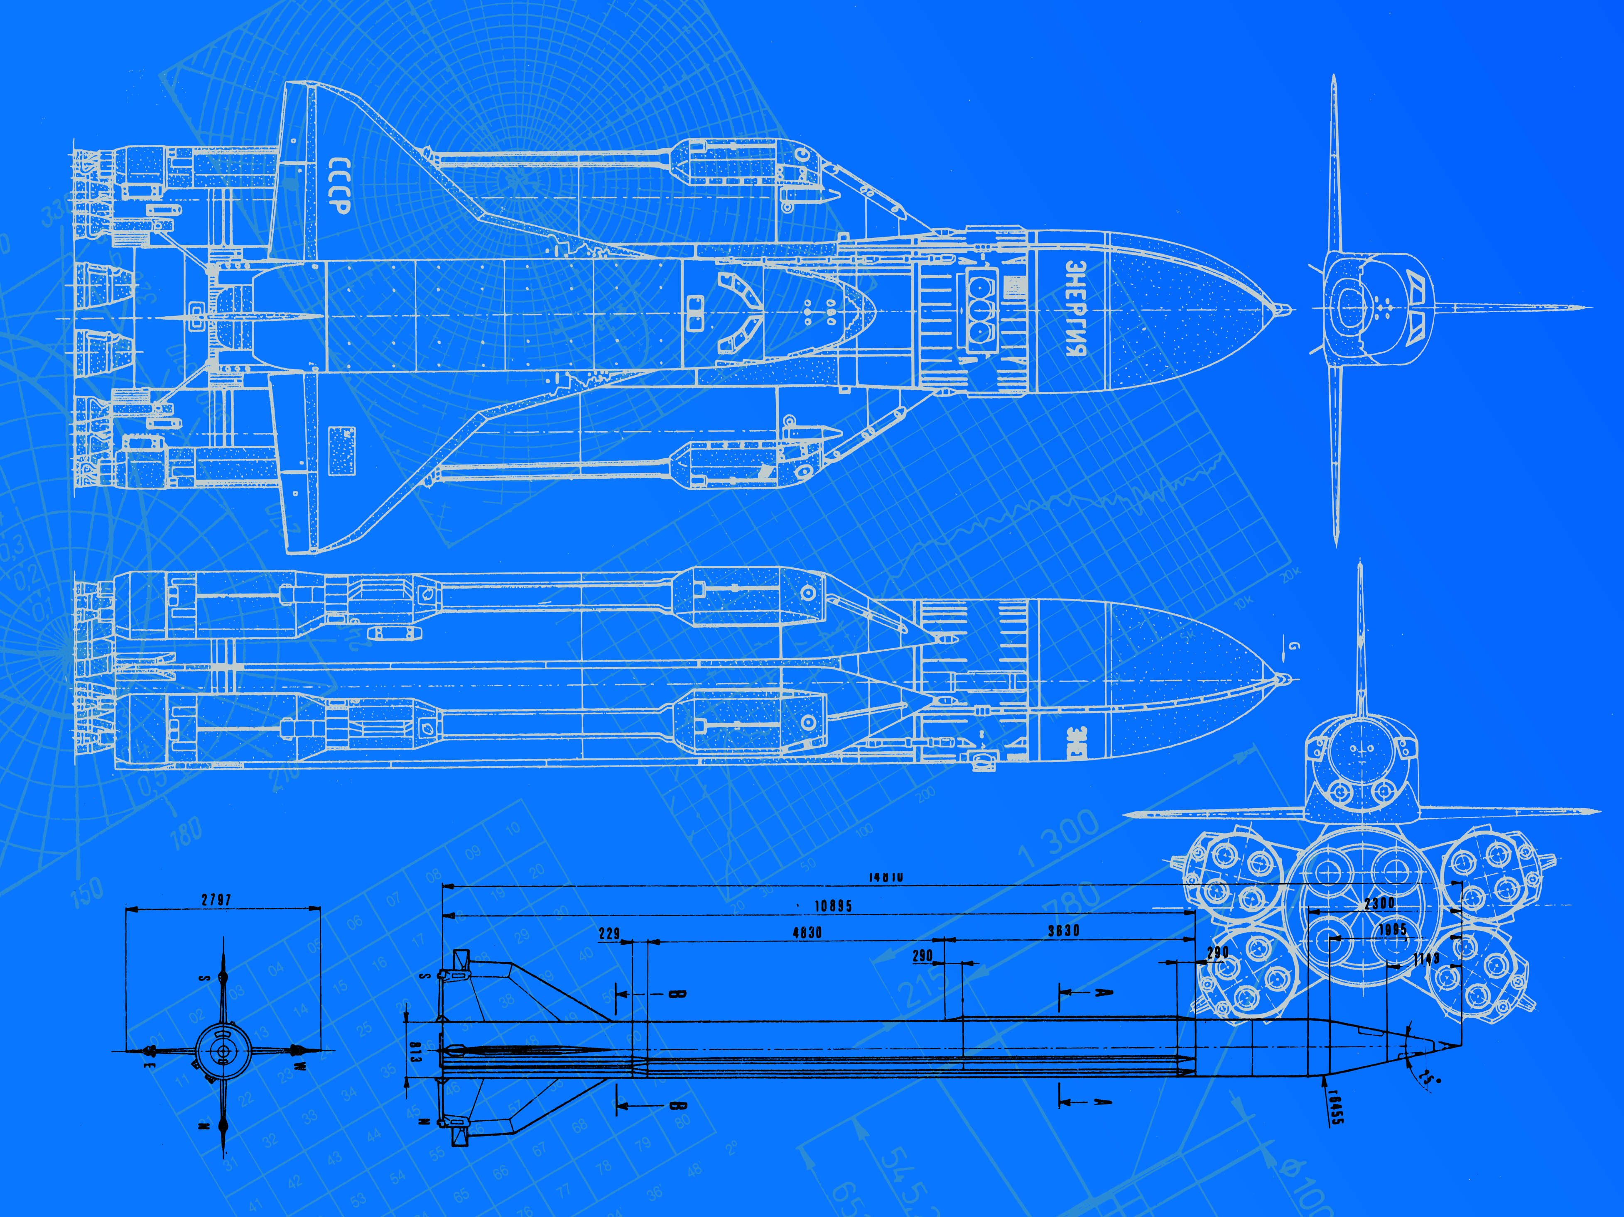
P4 as a specification language
Google uses P4 with non-programmable switches
They specify the intended switch behavior using P4
They use the resulting program for testing

Slide 8
Is P4 successful?
Academia
Absolutely!
Hundreds of papers using P4
1400 citations of original paper
Industry
Probably not (on switches)
No large deployments of programmable switches reported
Barefoot was bought cheaply

Slide 9
Arista presentation at P4 workshop 2019

Slide 10
P4 as an open-source project
Language design has been community-driven from the start
Everyone was (is) invited
But very few joined
Mostly as a hobby
Compiler was open-sourced from the start
Apache 2 license
Incumbents have no incentives for openness
Broadcom (the 800lb gorilla)
designed their own language NPL
never interested in interoperating with P4

Slide 11
P4₁₆ design seems to work
Core language evolves independently
Standard architectures evolve
Lots of interest around Portable NIC Architecture
Also around P4Runtime
More vendors are showing interest
Intel, Pensando (now AMD), Cavium, NVIDIA
Architectures have evolved without straining the language design
Open-source has produced some powerful tools
P4 isn’t yet a success, but it isn’t dead either

Slide 12
P4C: open-source P4 compiler
Extensible architecture
Shared front-end
Hundreds of little passes
7+2 open-source backends
For several architectures
Testing+simulation, open-flow, ebpf, XDP, DPDK
Several proprietary backends
FPGAs, ASIC, Smart NICs

Slide 13
The future of P4
It really depends on what the users ask for
And what they help implement
We prototype before we specify
We have a long list of desired features
But not enough resources to build everything
I think P4 should not become a general-purpose language
It should interoperate easily with native code C/C++/Rust
No payload processing (deep packet inspection)
Probably no L7 headers

Slide 14
Will P4 succeed?
Impossible to tell at this point
It may depend on our efforts!
“Never underestimate the power of a small group of committed people to change the world. In fact, it is the only thing that ever has.” Margaret Mead

Slide 15
Q&A
Q: Will there be a P4₂₃?
A: The naming scheme is unlike C. We introduced P4₁₆ because P4₁₄ was a terrible language. People still hate us for doing it. We use semantic versioning for the language; we are at P4₁₆ 1.2.3 now. I hope we never need to release P4₁₆ 1.3.x (which means breaking compatibility).
Q: What features are you planning to add to P4?
A: Many features do not require changing the language, rather the architectural models (e.g. PNA). In the language we hope to add modules, support code reuse, some macro-like iterators, varbit operations, safe unions, typeof, etc. Under design: https://github.com/p4lang/p4-spec/issues?page=2&q=is%3Aissue+is%3Aopen+label%3A%22Under+design%22

Slide 16
BACKUP SLIDES

Slide 17
P4 Language Overview
Suitable for switching devices
High-level, type-, memory-safe (no pointers)
Bounded execution (no loops)
Statically allocated (no malloc, no recursion)
Sub-languages:
Parsing headers
Packet header rewriting
Target architecture description

Slide 18
Language elements
Parser
State-machine; bitfield extraction
Match-action
units
Table lookup; bitfield manipulation; control flow
Reassembly
Bitfield packing
Data-types
Bitstrings, headers, structures, arrays
user
Target
description
target
Interfaces of programmable blocks
External libraries
Support for custom accelerators

Slide 19
What is missing
Floating point
Pointers, references
Data structures, recursive data types
Dynamic memory management (heap, malloc, free)
Loops, iterators (except the parser state-machine)
Recursion
Threads and concurrency
=> Constant work/byte of header

Slide 20
What cannot be done in (pure) P4
Multicast or broadcast
Queueing, scheduling, multiplexing
Payload processing: e.g., encryption
Packet trailers
Persistent state across packets
Communication to control-plane
Inter-packet operations (fragmentation and reassembly)
Packet generation
Timers

