Slide 1
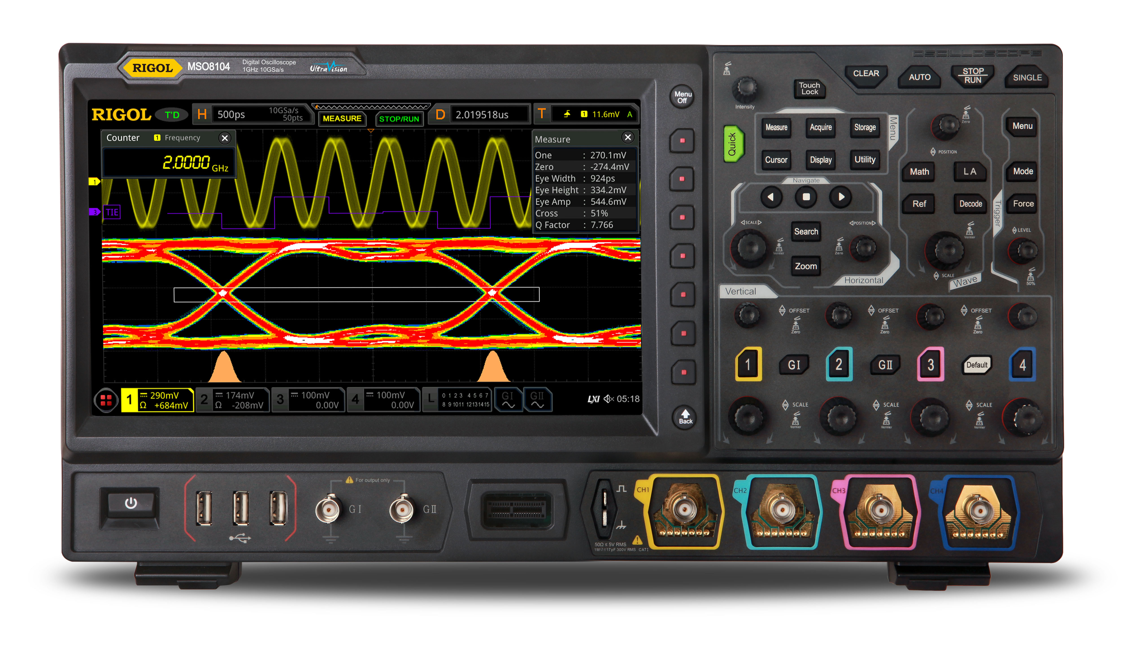
DBSP: Automatic Incremental View Maintenance for Rich Query Languages
Mihai Budiu, Leonid Ryzhyk - VMWare Research
Frank McSherry – Materialize.io
Val Tannen – University of Pennsylvania
June 15, 2022
Politehnica University Bucharest

Slide 2
A success story: VMware Skyline Proactive Intelligence
Identifying and resolving potential issues before they occur
VMware cloud service
https://www.vmware.com/support/services/skyline.html
Supports 8 different VMware products
Expert-written rules detect and report issues (e.g., misconfigurations)
Customer cloud
Skyline
service
DB & UI
configs
upgrades
telemetry
issues
Browse problems

Slide 3
Query execution in Skyline
1000+ queries
Issues?
Data (JSON)
To DB/UI
Horizontally partitioned across tenants.
Consumes JSON (tens of MB/doc)
Analyzes data in flight (no DB read/write)

Slide 4
Scalability
Four generations of the system built since 2017
First 3 use traditional database technologies
Non-incremental cost is O(|data| $×$ |queries|)
Incremental cost is O(|change| $×$ |queries|)
Incremental engine

Slide 5
Brief History
Differential Dataflow (DD): a framework for incremental computation (Murray, McSherry, et al, SOSP 2013) https://github.com/TimelyDataflow/differential-dataflow
Differential Datalog (DDlog): a programming language for incremental computation (Vmware Research, 2019) https://github.com/vmware/differential-datalog/ DDlog is the analytics engine in Skyline; build on DD
DBSP: formalize Differential Datalog (2021) https://github.com/vmware/database-stream-processor, https://arxiv.org/abs/2203.16684

Slide 6
Abstract
A simple language called DBSP
Four (4) operators
Based on Digital Signal Processing (DSP)
A formal definition of incremental computation in DBSP
An algorithm converting an arbitrary DBSP program to an incremental DBSP program
A recipe implementing DB queries in DBSP
https://arxiv.org/abs/2203.16684

Slide 7
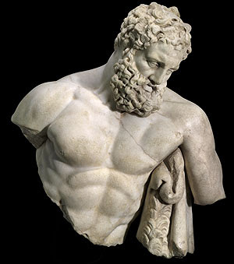
DBSP is powerful
It can model a rich class of database queries:
Relational (select, project, join, union, difference)
Computations on sets, bags, multisets
Nested relations (group-by, flatmap)
Aggregation
Recursion (monotonic and non-monotonic)
Stratified negation
Streaming computations (joins, window aggregates)
Relational while queries
More?
Corollary: we get automatically incremental evaluation for all these
The bold ones are new theoretical results in DD/DBSP
SQL
Datalog
CQL

Slide 8
What is incremental computation?
Consider a program $P$
Change $I$ “slightly”
In general, this is hard to even define precisely
But it works great for databases:
Databases have a natural notion of “changes”
$P$ is a query, $I$ is a set of tables, and $ΔI$ is a transaction
Usually $\left|ΔI\right|≪|I|$ and $\left|ΔO\right|≪|O|$
$$I$$
$$P$$
$$O$$
reuse
$$I+ΔI$$
$$P$$
$$O+ΔO$$

Slide 9
Outline
Basics of Digital Signal Processing
Incremental computation
Optimizing incremental circuits
Implementing queries in DBSP

Slide 10
Analog and digital signals
Analog to digital conversion
Digital to analog conversion

Slide 11
Nyquist–Shannon sampling theorem
If a signal contains no frequencies higher than B hertz, it is completely determined by giving its values at a series of points spaced 1/(2B) seconds apart.
Our ears cannot hear more than 20khz
CDs sampling rate is 44.1khz
Analog signal
Analog circuit
Analog signal
A/D
D/A
Digital signal
Program
Digital signal

Slide 12
Streams (signals)
A stream is a discrete sequence of values
Aka, an unbounded vector
$s =$ …
Formally: a function $s: ℕ → ℝ$
We write $s[t]$instead of $s(t)$
For this example: $s[0] = 0$, $s\left[1\right]=1$
We can have streams with values of any type $A$…
… denoted by $S_{A}= ℕ →A$
Audio streams are values in $S_{ℝ}$
0
1
2
1
0
-1
-2
-1

Slide 13
Stream operators
Functions from streams to streams:$Q:S_{A}→ S_{B}$
Operators can have multiple inputs: $T:S_{A_{0}}×S_{A_{1}}→S_{B}$
Streams = arrows, operators = boxes
We only deal with deterministic operators
$$i_{0}$$
$$i_{1}$$
$$i_{2}$$
…
$$Q$$
$$o_{0}$$
$$o_{1}$$
$$o_{2}$$
…
…
$$T$$
…
…

Slide 14
Lifting
Convert a function $f:ℝ→ℝ$ into a function $↑f:S_{ℝ}→S_{ℝ}$
Apply the function to each stream value
$↑f:Sℝ→Sℝ$ defined as $(↑f)\left(s\right)\left[t\right]=f\left(s\left[t\right]\right)$
Or $(↑f)\left(s\right)=f∘s$ (a stream $s: ℕ→ ℝ$ is also a function)
$$a$$
$$b$$
$$c$$
…
$$↑f$$
$$f(a)$$
$$f(b)$$
$$f(c)$$
…

Slide 15
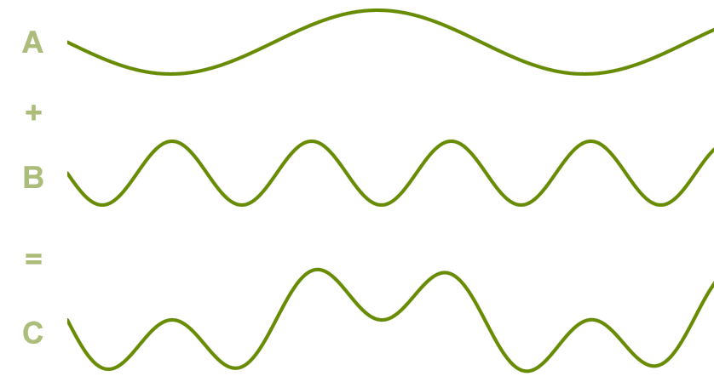
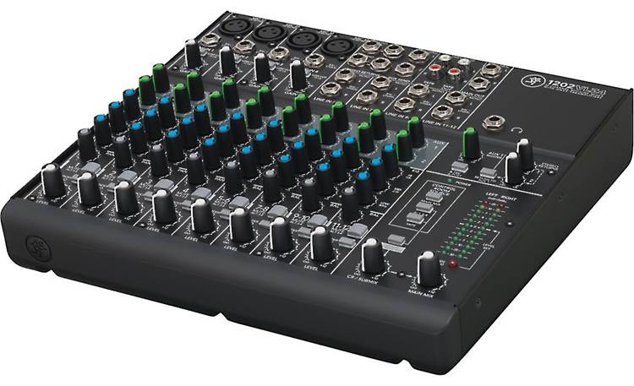
Addition
Given two (synchronized) streams we can add them pointwise
$+:S_{ℝ}×S_{ℝ}→S_{ℝ}$ by lifting $+: ℝ×ℝ→ℝ$
${(s}_{0} + s_{1})\left[t\right]= s_{0}\left[t\right]+ s_{1}[t]$
Audio mixing
$$1$$
$$2$$
$$3$$
…
+
5
7
$$9$$
…
$$4$$
$$5$$
$$6$$
…

Slide 16
The sound of silence
Special stream 0$:S_{ℝ}, 0\left[t\right]=0, ∀t∈ℕ$
0 is the neutral element for stream addition

Slide 17
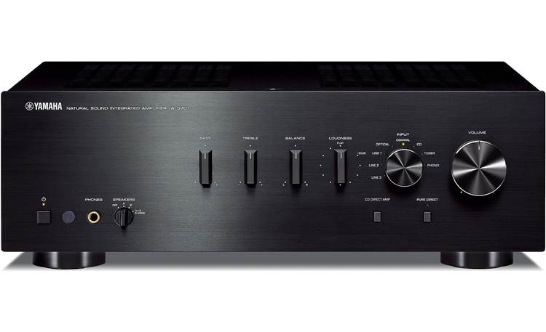
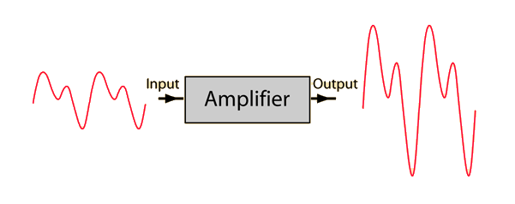
Amplification
Increase amplitude by a factor of $c$
Scaling function $a_{c}:ℝ→ℝ$, $a_{c}(x)≝cx$ lifted:
${↑ac: S}_{ℝ}→S_{ℝ},$ $((↑a_{c})\left(s\right))\left[t\right]=c⋅s[t]$
$$a$$
$$b$$
$$c$$
…
$$↑a_{c}$$
$$ca$$
$$cb$$
$$cc$$
…

Slide 18
Negation
Lifted unary minus
$−:S_{ℝ}→S_{ℝ}$
$\left(− s\right)\left[t\right]=−(s\left[t\right])$
$$a$$
$$b$$
$$c$$
…
$$−$$
$$−a$$
$$−b$$
$$−c$$
…

Slide 19
Delay ($z^{−1}$ )
Output is input delayed by one time unit
First value is 0
The name $z^{−1}$ comes from DSP (z-transform)
$$z^{−1}\left(i\right)\left[t\right]=\left\{\begin{aligned}0, t=0 \\ &i[t−1], t>0\end{aligned}\right.$$
$$a$$
$$b$$
$$c$$
$$d$$
…
$$z^{−1}$$
$$0$$
$$a$$
$$b$$
$$c$$
…

Slide 20
Chaining operators into circuits
Function composition
$$o=C(B(A\left(i1\right), D(i2))$$
i1
$$A$$
$$B$$
$$C$$
o
i2
$$D$$

Slide 21
Noise cancellation
Predict future values (easy for periodic signals)
Generate a negated stream
Add it to original stream
i
+
o
-

Slide 22
Circuit equivalence
Two circuits are equivalent iff they compute the same result given the same inputs
Function composition is associative => these circuits are equivalent:
$$A$$
$$B$$
$$C$$
$$⇔$$
$$A$$
$$B$$
$$C$$

Slide 23
Time-invariance
A stream operator $T$ is time-invariant if does not “depend on time”
i.e., if you delay the input, you get a delayed output
i.e., these two circuits equivalent:
DBSP only uses time-invariant operators
Example which is not time-invariant: $Q\left(s\right)\left[t\right]= s\left[t\right]+ t mod 2$

Slide 24
Causal operators
Operator $Q$ is causal if $Q(i)[t]$ only depends on $i\left[0\right]… i\left[t\right]$ (past and present inputs) and not on $i[t+1]$, … (future inputs)
All our operators are causal
Example non-causal operator: play a song in reverse

Slide 25
Differentiation
What does this circuit compute?
$o\left[t\right]=s\left[t\right]–s\left[t−1\right]$
$o\left[0\right]=s\left[0\right]$
o is the derivative of s
The discrete version of the continuous derivative
o
Denote this circuit by $D:S_{A}→S_{A}$
o is the stream of changes of s
$$1$$
$$2$$
$$3$$
$$2$$
…
$$D$$
$$1$$
$$1$$
$$1$$
$$−1$$
…
stream of changes

Slide 26
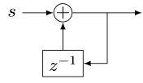
Integration
Denote this operator by $I: S_{A}→S_{A}$
If s is a stream of changes…
… then o is the original stream
What does this circuit compute?
This looks weird: o is recursively defined!
But it is well-defined
$o[0] =s[0]$
$o[t] =s[t] + o[t−1]$
Has a unique solution: $o\left[t\right]=\sum_{k=0}^{t}{s\left[t\right]}$
$o$ is the integral of $s$
The discrete version of the continuous indefinite integral
o
$$1$$
$$1$$
$$1$$
$$−1$$
…
$$I$$
$$1$$
$$2$$
3
$$2$$
…
stream of changes

Slide 27
Some properties
$I$ and $D$ are
deterministic
causal
time-invariant
Theorem: $I∘D=D∘I=id$ (or $I=D^{−1}$)

Slide 28
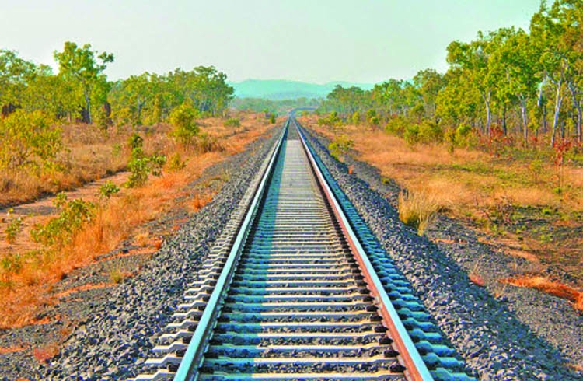
Linear operators
A unary stream operator $Q:S_{ℝ}→S_{ℝ}$ is linear if:
$$Q\left(s+t\right)=Q\left(s\right)+Q\left(t\right)$$
Theorem: amplification, $−$, $I$, $D$, $z^{−1}$ are linear
Theorem: the composition of linear operators is linear

Slide 29
Bilinear operators
A binary operator $⋈:S_{ℝ}×S_{ℝ}→S_{ℝ}$ is bilinear => if it distributes over addition
$$\left(s+t\right)⋈u=(s⋈u)+(t⋈u)$$
$$s⋈\left(u+v\right)=(s⋈u)+(s⋈v)$$
Example: lifted multiplication: $T\left(s,u\right)\left[t\right]=s\left[t\right]⋅u[t]$

Slide 30
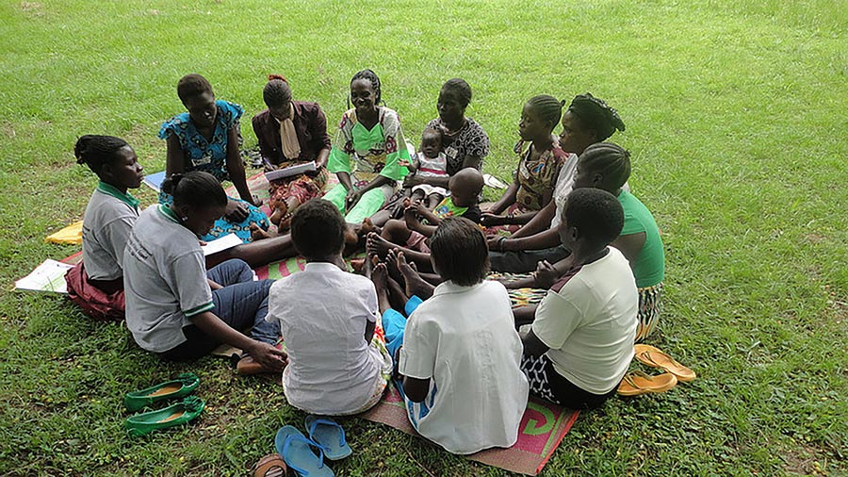
Streams are groups
Theorem: $S_{ℝ}$ is a commutative group
Recall that a group has 3 operations:
an associative addition operation: $a+b$
a neutral element for addition 0
and an inverse for each element (negation):$−a$
Generally: If $A$is a commutative group, $SA$ is also a commutative group
All streaming operations/properties described so far are well-defined/hold for an arbitrary commutative group $SA$
Time-invariance, determinism, causality, integration, differentiation, linearity, bilinearity, delay, etc. (except amplification)

Slide 31
Outline
Basics of Digital Signal Processing
Incremental computation
Optimizing incremental circuits
Implementing queries in DBSP

Slide 32
All databases are streaming databases!
Consider a database $DB$, a set of tables
A committed transaction is a change to $DB$
The set of linearized transactions define $T,$ a stream of changes to $DB$
$T[t]$is the $t$-th transaction
$DB$ is a stream of database snapshots
$DB[t]$ is the contents of the database after $t$ transactions have been executed
We have: $DB[t] = I(T(t))$ – the integral of the transaction stream
$$T_{0}$$
$$T_{1}$$
$$T_{2}$$
$$T_{3}$$
…
$$I$$
$${DB}_{0}$$
$${DB}_{1}$$
$${DB}_{2}$$
$${DB}_{3}$$
…

Slide 33
Views
Let $Q$ be a query defining a view $V$ as a function of the database, e.g.:
CREATE VIEW V AS SELECT * FROM T WHERE Age >= 10
$V[t]=Q\left(DB[t]\right)$
$V$ is a stream of view snapshots:
$$V= ↑Q(DB)$$
$$↑Q$$
$$V_{0}$$
$$V_{1}$$
$$V_{2}$$
$$V_{3}$$
…
Versions of $V$
Versions of $DB$
$${DB}_{0}$$
$${DB}_{1}$$
$${DB}_{2}$$
$${DB}_{3}$$
…

Slide 34
Incremental view maintenance
The incremental maintenance of $V$ is performed by the operator
${(↑Q)}^{Δ}≝ D∘(↑Q)∘I$
$${(↑Q)}^{Δ}$$
$$T_{0}$$
$$T_{1}$$
$$T_{2}$$
$$T_{3}$$
…
$$I$$
$$↑Q$$
D
$$ΔV_{0}$$
$$ΔV_{1}$$
$$ΔV_{2}$$
$$ΔV_{3}$$
…
Changes to $DB$
Changes to $V$
$$V_{0}$$
$$V_{1}$$
$$V_{2}$$
$$V_{3}$$
…
Versions of $V$
Versions of $DB$
$${DB}_{0}$$
$${DB}_{1}$$
$${DB}_{2}$$
$${DB}_{3}$$
…

Slide 35
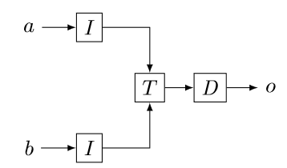
Multiple inputs
This generalizes to operators with multiple inputs or outputs
E.g., for a binary stream operator $T:S_{A_{0}}×S_{A_{1}}→S_{B}$
$$T^{Δ}$$

Slide 36
Fundamental Equation of Incremental View Maintenance
$$Q^{Δ}=D∘Q∘I$$
As written, $Q^{Δ}$ is expensive to compute
However, we can often optimize the computation significantly

Slide 37
Incremental queries are streaming systems
$${Δi}_{0}$$
$${Δi}_{1}$$
$${Δi}_{2}$$
$${Δi}_{3}$$
…
$$Q^{Δ}$$
$$Δo_{0}$$
$$Δo_{1}$$
$$Δo_{2}$$
$$Δo_{3}$$
…
state
$Q^{Δ}$ is a streaming system:
it runs forever
it has internal state (even if $Q$ is stateless)

Slide 38
Outline
Basics of Digital Signal Processing
Incremental computation
Optimizing incremental circuits
Implementing queries in DBSP

Slide 39
Linear operators
Theorem: For a linear stream operator $Q$ we have $Q=Q^{Δ}$
(most operators used in DB queries are linear)
Why is this better?
Incremental operators compute over changes; assume $\left|T\left[t\right]\right|≪|DB[t]|$
Original:
Optimized:
A speedup of $O(\left|DB\right|/|T|)$
$$T_{0}$$
$$T_{1}$$
$$T_{2}$$
$$T_{3}$$
…
$$I$$
$$Q$$
D
$$ΔV_{0}$$
$$ΔV_{1}$$
$$ΔV_{2}$$
$$ΔV_{3}$$
…
$${DB}_{0}$$
$${DB}_{1}$$
$${DB}_{2}$$
$${DB}_{3}$$
…
$$T_{0}$$
$$T_{1}$$
$$T_{2}$$
$$T_{3}$$
…
$$Q$$
$$ΔV_{0}$$
$$ΔV_{1}$$
$$ΔV_{2}$$
$$ΔV_{3}$$
…

Slide 40
Example of a linear query
CREATE VIEW V AS SELECT * FROM T WHERE Age >= 10
You don’t need to know what’s in T to compute the changes to V
If you change T by adding $Δ$T…
…this (same) query computes $Δ$V:
SELECT DISTINCT * FROM $Δ$T WHERE Age >= 10

Slide 41
The chain rule
$$(Q_{2}{∘Q_{1})}^{Δ}=Q_{2}^{Δ}∘Q_{1}^{Δ}$$
Proof by pictures:
We can incrementalize a complex circuit by incrementalizing each component independently
For a chain of linear operators: $(Q_{2}{∘Q_{1})}^{Δ}=Q_{2}^{Δ}∘Q_{1}^{Δ}=Q_{2}∘Q_{1}$
$$⇔$$
$$⇔$$
$$⇔$$

Slide 42
Bilinear operators
(Lifted) join, intersection, Cartesian product
From distributivity:$Δ\left(A×B\right)=\left(A×ΔB\right)+\left(ΔA×B\right)+\left(ΔA×ΔB\right)$
Speed-up is $O(\min\left(\left|ΔA\right|/\left|A\right|, \left|ΔB\right|/\left|B\right|\right))$
$$⇔$$

Slide 43
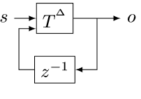
The cycle rule
$$⇔$$
Allows us to recursively incrementalize circuits with feedback
All our circuits are built from:
Sequential composition
Feedback loops
We get a structural recursion scheme for incrementalizing any circuit

Slide 44
Internal state
Incremental lifted join circuit
An incremental operator has internal state
Even if original operator was stateless
State is held in $z^{−1}$
There are $z^{−1}$s inside $I$ and $D$ too
The state inside $I$ is as large as the whole input (integral of all changes)
However, the work of the incremental join operator at time $t$ is just $O(|a[t]|)$ --- and not $O(|I(a[t])|)$

Slide 45
Outline
Basics of Digital Signal Processing
Incremental computation
Optimizing incremental circuits
Implementing Queries in DBSP

Slide 46
Computing on tables
SQL queries are functions from tables to tables: $$Q:T_{0}×…×T_{n}→T$$
T
Query
Query result
Name | Age
Mike | 10
John | 12
Amy | 8
Chris | 10
Name | Age
Mike | 10
John | 12
Chris | 10
SELECT * FROM T WHERE Age >= 10

Slide 47
Hold on! This is not well-defined!
The definitions of $I$, $D$ require streams over a commutative group
$I:S_{A}→S_{A}$ for some commutative group $A$
However, tables (sets, multisets) are not groups
E.g., there is no table negation
Solution:
Generalize tables to obtain a commutative group

Slide 48
$ℤ$-sets (also called $ℤ$-relations)
Generalize sets so that each element has an integer weight
The weight can be positive, zero, or negative
You can think of a $ℤ$-set as a key-value map where
Key is the tuple
Value is the integer weight
Formally: a $ℤ$-set is a function $r: T→ℤ$
With finite support (finite number of rows)
$T$ is the type of the tuples
Convenient notation $ℤ\left[T\right] ≝\{ r:T→Z \}$
Like an associative array indexed with a tuple from $T$
Name | Age | Weight
Mike | 10 | 1
John | 12 | 3
Amy | 8 | -1
Chris | 10 | 2
tuples

Slide 49
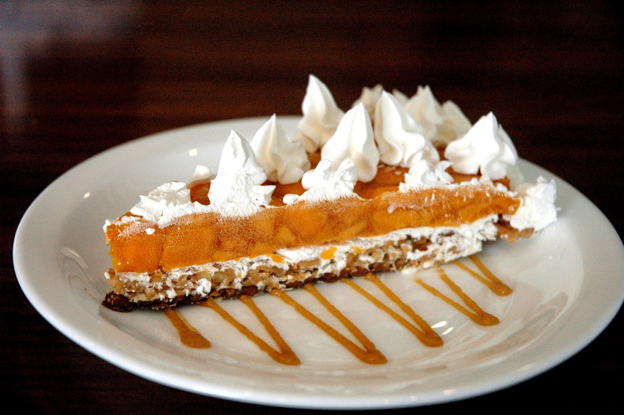
$ℤ$-sets are yummy!
Can represent both tables and changes to tables
Positive weights = elements added
Negative weights = elements removed
Generalize sets and multisets
Classic DB table = $ℤ$-set where all weights are 1
Form a commutative group (because $ℤ$ is a group)
Addition just adds the weights of tuples
Zero is an empty table
Negation just negates all weights

Slide 50
Example: $ℤ$-set addition
Name | Weight
Mike | 1
John | 3
Amy | -1
Chris | 2
Name | Weight
Mike | -1
Dan | 1
Chris | 1
Name | Weight
Dan | 1
John | 3
Amy | -1
Chris | 3
+
=

Slide 51
The distinct operator
“Converts” a $ℤ$-set into a set
$distinct\left(r\right)\left[t\right]= \left\{\begin{aligned}1 if r\left[t\right]>0 \\ 0 otherwise\end{aligned}\right.$
Name | Weight
Dan | 1
John | 3
Amy | -1
Chris | 3
Name | Weight
Dan | 1
John | 1
Chris | 1
$$distinct\left( \right)=$$

Slide 52
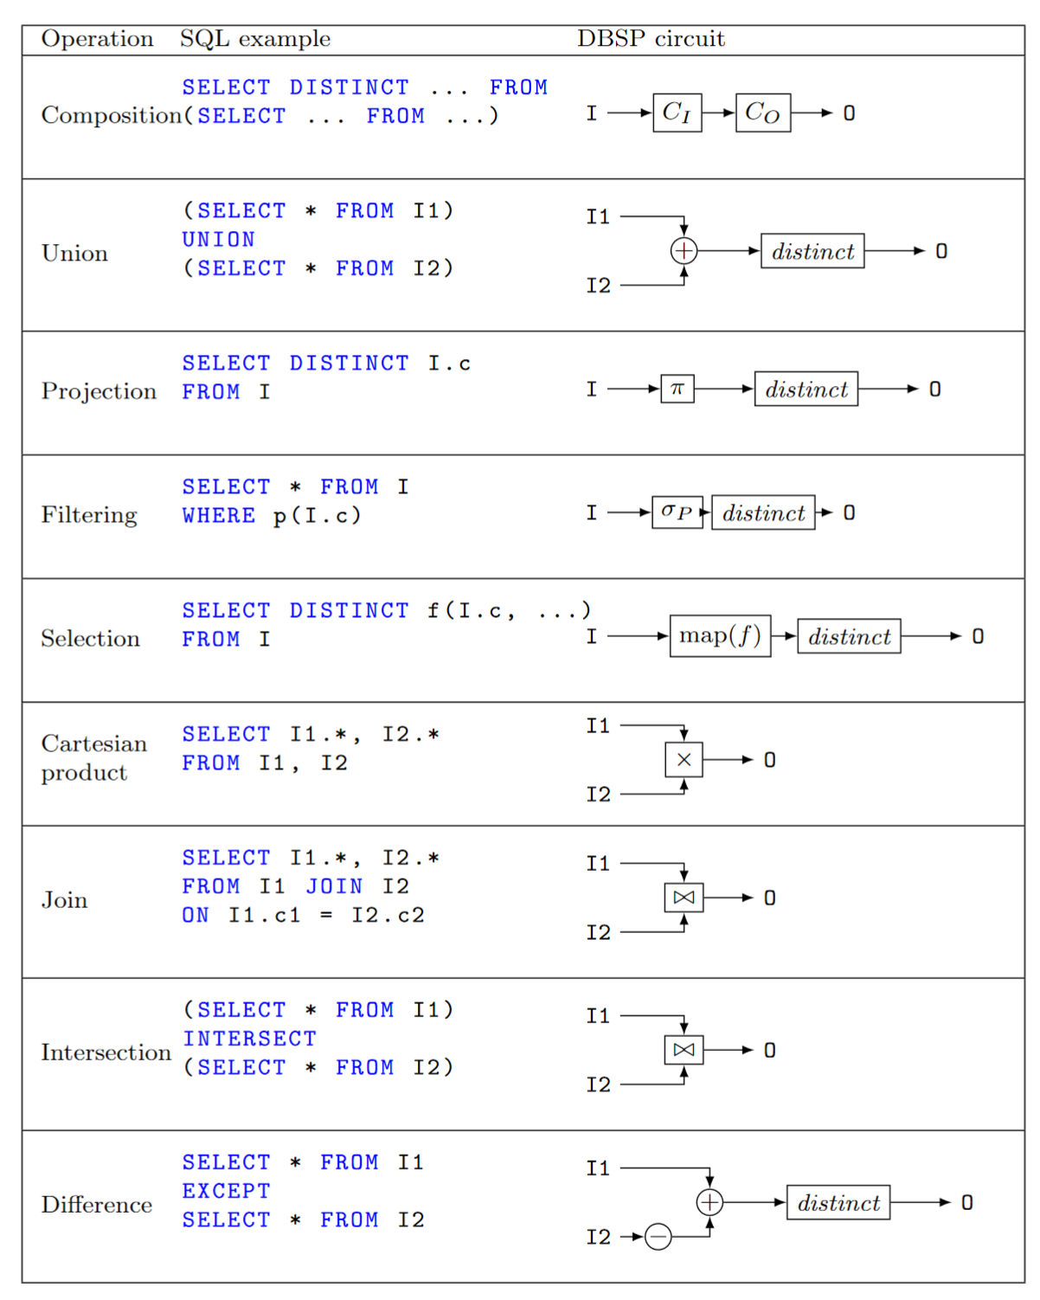
Relational algebra using $ℤ$-set operations
Recursively defined on query structure
Many operations require a $distinct$
The other operations are all linear or bilinear
Many $distinct$ operations can be further removed
${\left(↑distinct\right)}^{Δ}$ can be computed efficiently

Slide 53
Recursion
Operator producing stream $(i, 0, 0, 0, …)$ from input $i$
$$o[0] =Q(i)$$
$$o\left[t\right]= Q\left(o\left[t−1\right]\right)=Q^{t+1}\left(i\right)$$
This circuit computes the fixpoint of $Q$
$$o$$
$$∫$$
“Loop termination” operator

Slide 54
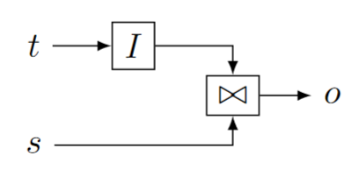
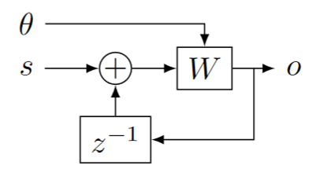
Streaming queries
Streaming joins
$t$ are changes to a table
$s$ is a stream
Table $I(t)$ is joined with every stream value in $s$
$o$ is also a stream
Convolutions
Standard DSP Finite-Impulse-Response filters
Streaming window queries
$θ$ is a stream of wall-clock values (time)
$s$ is a stream of timestamped data
$W$ window function, filters data in $s$ based on timestamp and time

Slide 55
Definition of Differential Datalog
The Differential Datalog compiler
receives as input a query $Q$, written in Datalog
Produces as output an implementation of $Q^{Δ}$, written in Rust
stream of input changes
DDLog
program
DDlog compiler
Rust
Program
$$Q^{Δ}$$
Rust compiler
Native library
$$Q$$
stream of output changes
Differential dataflow
library

Slide 56
We’re only getting started!
Core DBSP library
Parallel and distributed execution
Formal verification
Persistence
Fault-tolerance
Load-balancing
Runtime queries
Cloud service
Integration in existing systems (SQL, Spark, Rust, etc.)
Applications

Slide 57
Summary
DSP circuits are a nice model of streaming computation
Four operators: $z^{−1}, ↑, δ_{0}, ∫$
Circuits can compute on $ℤ$-sets (changes to DBs)
Recipe for incremental view maintenance:
Translate a DB query into a streaming circuit $Q$
Build incremental version of circuit:
$$Q^{Δ}≝D∘Q∘I$$
Efficiently implement $Q^{Δ}$ by optimizing circuit:
$$(Q{∘R)}^{Δ}=Q^{Δ}∘R^{Δ}$$

Slide 58
Extra slides

Slide 59
Related work
Incremental View Maintenance
Streaming Databases
Streaming languages
Functional Languages
Category theory
Dataflow machines
Synchronous circuits

Slide 60
Materialized View Update Problem
We essentially cover this whole space
IEEE Data Engineering Bulletin, 1995

Slide 61
Datalog
Essentially an alternative language to SQL for describing views (Datalog views are always sets – no duplicates allowed)
Differential Datalog (DDlog) is a dialect of Datalog with extra features
CREATE VIEW V AS
SELECT DISTINCT * FROM T
WHERE Age >= 10
V(name, age) :- T(name, age), age >= 10.
SQL
Datalog

Slide 62
Set intersection
SELECT * FROM T1 INTERSECT SELECT * FROM T2
O(x) :- T1(x), T2(x).
This is a disguised JOIN. We will see it soon.

Slide 63
Projection
SELECT Age FROM T
In DDlog:
O(age) :- T(_, age).
The weight of $t$ = sum of weights of all tuples that project to $t$
$$π_{C}\left(m\right)\left[t\right]=\sum_{\begin{aligned}x∈m \\ π_{C\left(x\right)}=t\end{aligned}}{m[x]}$$
$$T$$
$${↑π}_{C}$$
$$distinct$$
$$V$$
Name | Age | Weight
Mike | 10 | 1
John | 12 | 3
Amy | 8 | -1
Chris | 10 | 2
Age | Weight
10 | 1+2
12 | 3
8 | -1
SELECT Age

Slide 64
Translating a DDlog rule
Rule head
Rule body
RelationHead :- RelationTerm0, not RelationTerm1.
Head relation = circuit output
Relations in body = circuit inputs
Rule body = circuit contents
Edges in circuit = conjunctions in rule body
Turnstyle = projection
Compiled to
RelationTerm0
proj
RelationHead
RelationTerm1

Slide 65
Multiset union (can have duplicates)
CREATE VIEW V AS SELECT * FROM T1 UNION ALL SELECT * FROM T2
From now on I will omit the “CREATE VIEW” part.
T1
+
V
T2

Slide 66
Set union (no duplicates)
SELECT * FROM T1 UNION SELECT * FROM T2
V(x) :- T1(x). V(x) :- T2(x).
SQL
Datalog
T1
+
$$↑distinct$$
V
T2

Slide 67
Set difference
SELECT * FROM T1 EXCEPT SELECT * FROM T2
V(x) :- T1(x), not T2(x).
T1
+
$$↑distinct$$
V
T2
-
Note: distinct will remove elements with negative weights

Slide 68
Selection (filtering)
SELECT * FROM T WHERE predicate
O(t) :- T(t), predicate(t).
Name | Age | Weight
Mike | 10 | 1
John | 12 | 3
Amy | 8 | -1
Chris | 10 | -2
Name | Age | Weight
Mike | 10 | 1
John | 12 | 3
Chris | 10 | -2
WHERE Age >= 10

Slide 69
Selection (filtering)
SELECT * FROM T WHERE predicate
V(t) :- T(t), predicate(t).
$$σ:ℤ\left[T\right]→ℤ[T]$$
$$σ\left(m\right)[t]=\left\{\begin{aligned}m\left[t\right], if predicate(t) \\ 0, otherwise\end{aligned}\right.$$
$$T$$
$$↑σ$$
V
$σ$ keeps all tuples for which the predicate is true.

Slide 70
Query composition
SELECT … FROM (SELECT … FROM …)
E(y) :- T(x),…. V(z) :- E(y),….
E
Table
$$Q_{1}$$
$$Q_{2}$$
O
Query composition is circuit chaining (function composition).

Slide 71
Cartesian products
V(t1, t2) :- T1(t1), T2(t2).
SELECT T1.*, T2.* FROM T1, T2
Name | Age | Weight
Mike | 10 | 1
John | 10 | 3
Amy | 10 | -1
Chris | 10 | 2
Mike | 12 | 3
John | 12 | 9
Amy | 12 | -3
Chris | 12 | 6
Name | Weight
Mike | 1
John | 3
Amy | -1
Chris | 2
Age | Weight
10 | 1
12 | 3
x
=
Multiply weights.

Slide 72
Cartesian products
V(t1, t2) :- T1(t1), T2(t2).
SELECT T1.*, T1.* FROM T1, T2
$m_{1}∈ℤ\left[T_{1}\right],$ $m_{2}∈ℤ\left[T_{2}\right]$, ($m_{1}×m_{2})\left[\left(t_{1}, t_{2}\right)\right]≝m_{1}\left[t_{1}\right]⋅m_{2}\left[t_{2}\right]$
T1
$$↑×$$
V
T2

Slide 73
(Equi)Joins
SELECT Name, Age FROM T1 JOIN T2 ON T1.Name=T2.Name
O(Name, Age) :- T1(Name, Age), T2(Name, _).
T1
$$↑×$$
$$↑σ$$
V
T2
Cartesian product followed by filtering.

Slide 74
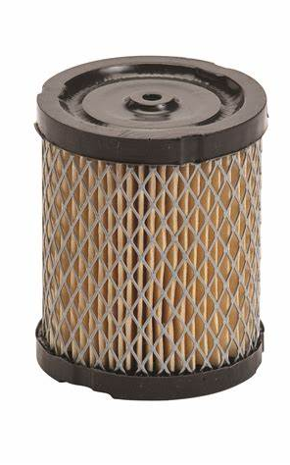
DSP Filters
Most circuits in DSP are composed of linear, time-invariant blocks
These have some very nice mathematical properties
In particular, their output is fully described by their response to an “impulse” (the stream 1,0,0,0…)
Given their impulse response R and an input signal S, the output is R * S – the convolution of R and S
$I$ is an IIR filter – Infinite Impulse Response (1,1,1,1,…)
$D$ is a FIR filter – Finite Impulse Response (1,-1,0,0,….)
However, many of the computations we will need are not linear
So most of the beautiful DSP theory does not apply

Slide 75
Relation to synchronous digital circuits
Combinational logic (acyclic graphs)
“Instantaneous” propagation
Flip-flops or latches (memory elements)
Clocked elements
Remember value from previous clock
This is our delay element $z^{−1}$
Sequential circuits
Combinational logic
All back-edges must go through a latch
clock
input
Combinational
circuit
output
state

Slide 76
Synchronous circuits ideas
The entire state is stored in latches
State summarizes the entire history of the circuit
State = checkpoint.
Optimizations such as retiming can be used to minimize state
Retiming moves around latches without changing the circuit semantics

Slide 77
DBSP vs Differential Dataflow
DBSP is inspired by DD
https://github.com/TimelyDataflow/differential-dataflow
DBSP is much simpler than DD
DD has the notion of “change” built-in
In DBSP the changes are obtained by using $D$ and $I$
DD is more general
DBSP requires that input changes are streamed in time order
In DD changes can be made at any time, not just in time order

Slide 78
Recursive computations
Reach(x, y) :- Edge(x, z), Reach(z, y).
Very nasty in SQL
The implementation iterates until convergence.
We will introduce two new circuit elements to create (inner) loops.

Slide 79
Creating streams from scalars
An operator that creates a stream from a scalar value
$$δ_{0}:A→S_{A}$$
$$δ_{0}\left(a\right)\left[t\right]≝\left\{\begin{aligned}a, t=0 \\ &0, t>0\end{aligned}\right.$$
scalar
stream
9
9, 0, 0, 0, 0, 0, …

Slide 80
Creating scalars from streams
This operator is only defined for streams that have a finite number of non-zero elements (they are zero almost everywhere, a.e.)
$$∫{ :S}_{A}→A$$
$$∫\left(s\right) ≝ \sum_{t≥0}{s[t]}$$
Add all values in stream. Well-defined if stream is 0 a.e.
stream
scalar
1, 2, 3, 0, 0, 0, …
6

Slide 81
Creating a loop
These two operators are always used in pairs as follows:
Most useful when $Q$ has a recursive definition:
$$o[0] =Q(i)$$
$$o\left[t\right]= Q\left(o\left[t−1\right]\right)=Q^{t+1}\left(i\right)$$

Slide 82
Streams of Streams
$S_{A}$ is defined for any group $A$
$S_{A}$ itself is a group
So we can talk about $S_{S_{A}}$!
These show up in the implementation of loops

Slide 83
Lifting a loop
The circuit can be treated as a scalar operator
So it can be lifted to operate on stream like any other scalar operator

Slide 84
Simplest recursion scheme
O = R(I, O) where I and O are relations, and R is a query.
Implement non-recursive R as a circuit $R$
Lift circuit and connect feedback:
Theorem: this computes O given I
I

Slide 85
Semi-naïve evaluation
$$⇔$$
This proves the correctness of semi-naïve Datalog evaluation

Slide 86
Incremental recursive circuits
Start with semi-naïve evaluation circuit :
Lift the circuit ($T=distinct∘R)$:
Incrementalize:
Apply chain and cycle rules:

Slide 87
Transitive closure
reach(x, y) :- edge(x, y).
reach(x, y) :- edge(x, z), reach(z, y).
edge
reach
edge
join(edge, reach)

Slide 88
Map
Given a function $f:A→B$ the operator map$\left(f\right):ℤ\left[A\right]→ ℤ[B]$ is defined as: map$\left(f\right)\left(i\right)=\sum_{x∈i}{i\left[x\right]⋅f(x)}$
Synthesized from DDlog programs such as O(v) :- I(x), var v = f(x).
The implementation lifts map$(f)$ to every element of a stream
Note: map$(f)$is linear for any function $f$

Slide 89
Aggregation
Aggregation functions such as SUM, COUNT are linear functions between $ℤ[ℝ]$ and $ℝ$
But not between $ℤ[ℝ]$ and $ℤ[ℝ]$!
SELECT SUM(c) FROM I
makeset converts a $ℝ$scalar into a singleton $ℤ$-set
makeset$\left(x\right)≝1⋅x$
$a_{SUM}(s)=\sum_{x∈s}{x×s\left[x\right]}$ weighted sum is linear

Slide 90
Flatmap
Given a function $f:A→ℤ[B]$, the operator flatmap$\left(f\right):ℤ\left[A\right]→ ℤ[B]$ is defined as: flatmap$\left(f\right)\left(i\right)=\sum_{x∈i}{i\left[x\right]⋅f(x)}$
Same definition as map, but the type of $f$ is different
In DDlog Flatmap is a keyword and has no function parameter
input relation I(set: Set<T>) output relation O(t: T) O(v) :- I(set), v = Flatmap(set). // O = union of all sets in I
Flatmap = flatmap$(x↦ 1⋅x)$
Flatmap is also a linear transformation on streams

Slide 91
Group-by
Given an arbitrary type of keys $K$ and a function $k: A→K$, the function groupby$\left(k\right): ℤ\left[A\right]→ℤ\left[A\right]\left[K\right]$
$ℤ\left[A\right]\left[K\right]$ is a group
groupby is a linear function!

Slide 92
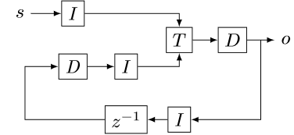
Proof of the cycle rule
$$⇔$$
$$⇔$$

Slide 93
Nested incremental computation
Let us consider $f:A→B$
If $A, B$ are scalar types, define $f^{Δ}=f$
Take $↑g:S_{A}→S_{B}$
Define recursively ${(↑g)}^{Δ}=D∘g^{Δ}∘I$
We have ${\left(↑↑f\right)}^{Δ}=D∘\left(↑D\right)∘(↑↑f)∘\left(↑I\right)∘I$
For a linear $f$ we still have ${\left(↑↑f\right)}^{Δ}=f$

Slide 94
Optimizing distinct
Distinct is idempotent: $distinct∘distinct=distinct$
For many relational queries Q the following two are equivalent ($Q$ one of select, project, join, map, flatmap, union, intersection)
For Q in join, product, filter, select we have

Slide 95
Incremental distinct

