Slide 1
DBSP: Automatic Incremental View Maintenance for Rich Query Languages Part II: advanced queries
Mihai Budiu, Leonid Ryzhyk - VMWare Research
Frank McSherry – Materialize.io
Val Tannen – University of Pennsylvania
July 21, 2022
Relational.AI

Slide 2
Tips welcome!
Not that kind of tips…
Grateful for feedback or contributions
Write-up
Presentation
Implementation
https://arxiv.org/abs/2203.16684
https://github.com/vmware/database-stream-processor
https://github.com/vmware/sql-to-dbsp-compiler

Slide 3
Abstract
A simple language called DBSP
Four (4) operators [saw 2 last time]
Based on Digital Signal Processing (DSP)
A formal definition of incremental computation in DBSP
An algorithm converting an arbitrary DBSP program to an incremental DBSP program
A recipe implementing DB queries in DBSP

Slide 4
DBSP can model a rich class of queries
Relational (select, project, join, union, difference)
Computations on sets, bags, multisets
Nested relations (group-by, flatmap)
Aggregation
Recursion (monotonic and non-monotonic)
Stratified negation
Streaming computations (joins, window aggregates)
More
Last time
SQL
Today
Datalog
CQL

Slide 5
Outline
Recap: streaming and incremental computations
SQL in DBSP
Streaming queries in DBSP
Datalog in DBSP

Slide 6
Streams
$S_{A}= ℕ →A$
$(A, +, −, 0)$ must be a commutative group
Stream operators: $T:S_{A_{0}}×S_{A_{1}}→S_{B}$
We only use deterministic, causal, time-invariant operators
Lifting: create from $f:A→B$ an operator $↑f:S_{A}→S_{B}$ applied pointwise
Delay operator:
…
$$T$$
…
…
$$a$$
$$b$$
$$c$$
$$d$$
…
$$z^{−1}$$
$$0$$
$$a$$
$$b$$
$$c$$
…

Slide 7
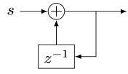
Stream Differentiation and Integration
$$D$$
$$I$$
o
o
$$1$$
$$2$$
$$3$$
$$2$$
…
$$D$$
$$1$$
$$1$$
$$1$$
$$−1$$
…
$$I$$
$$1$$
$$2$$
3
$$2$$
…
stream of changes

Slide 8
Linearity and bilinearity
$Q$ is linear if:
$$Q\left(s+t\right)=Q\left(s\right)+Q\left(t\right)$$
$⋈$ is bilinear if it distributes over addition
$$\left(s+t\right)⋈u=(s⋈u)+(t⋈u)$$
$$s⋈\left(u+v\right)=(s⋈u)+(s⋈v)$$

Slide 9
Definition: Incremental view maintenance
The incremental maintenance of a view $V$ = $Q(DB)$is performed by
${(↑Q)}^{Δ}≝ D∘(↑Q)∘I$
$${(↑Q)}^{Δ}$$
$$T_{0}$$
$$T_{1}$$
$$T_{2}$$
$$T_{3}$$
…
$$I$$
$$↑Q$$
D
$$ΔV_{0}$$
$$ΔV_{1}$$
$$ΔV_{2}$$
$$ΔV_{3}$$
…
Changes to $DB$
Changes to $V$
$$V_{0}$$
$$V_{1}$$
$$V_{2}$$
$$V_{3}$$
…
Versions of $V$
Versions of $DB$
$${DB}_{0}$$
$${DB}_{1}$$
$${DB}_{2}$$
$${DB}_{3}$$
…

Slide 10
Incremental queries are streaming systems
$${Δi}_{0}$$
$${Δi}_{1}$$
$${Δi}_{2}$$
$${Δi}_{3}$$
…
$$Q^{Δ}$$
$$Δo_{0}$$
$$Δo_{1}$$
$$Δo_{2}$$
$$Δo_{3}$$
…
state
$Q^{Δ}$ is a streaming system:
it runs forever
it has internal state (even if $Q$ is stateless)

Slide 11
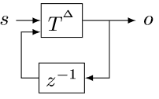
Properties of $Δ$
For linear $Q: Q=Q^{Δ}$
Chain rule: $(Q_{2}{∘Q_{1})}^{Δ}=Q_{2}^{Δ}∘Q_{1}^{Δ}$
For bilinear $×$
Cycle rule:
$$⇔$$
$$⇔$$

Slide 12
Outline
Recap: streaming and incremental computations
SQL (and beyond) in DBSP
Streaming queries in DBSP
Datalog in DBSP

Slide 13
$ℤ$-sets
Generalize sets so that each element has an integer weight
The weight can be positive, zero, or negative
A$ℤ$-set is a (finite support) function $r: T→ℤ$ = $ℤ\left[T\right]$
$T$ is the type of the tuples
Form a commutative group (because $ℤ$ is a group)
Represent both tables and changes to tables
$distinct$ “converts” a $ℤ$-set into a set (“clips” weights)
Name | Age | Weight
Mike | 10 | 1
John | 12 | 3
Amy | 8 | -1
Chris | 10 | 2
tuples

Slide 14
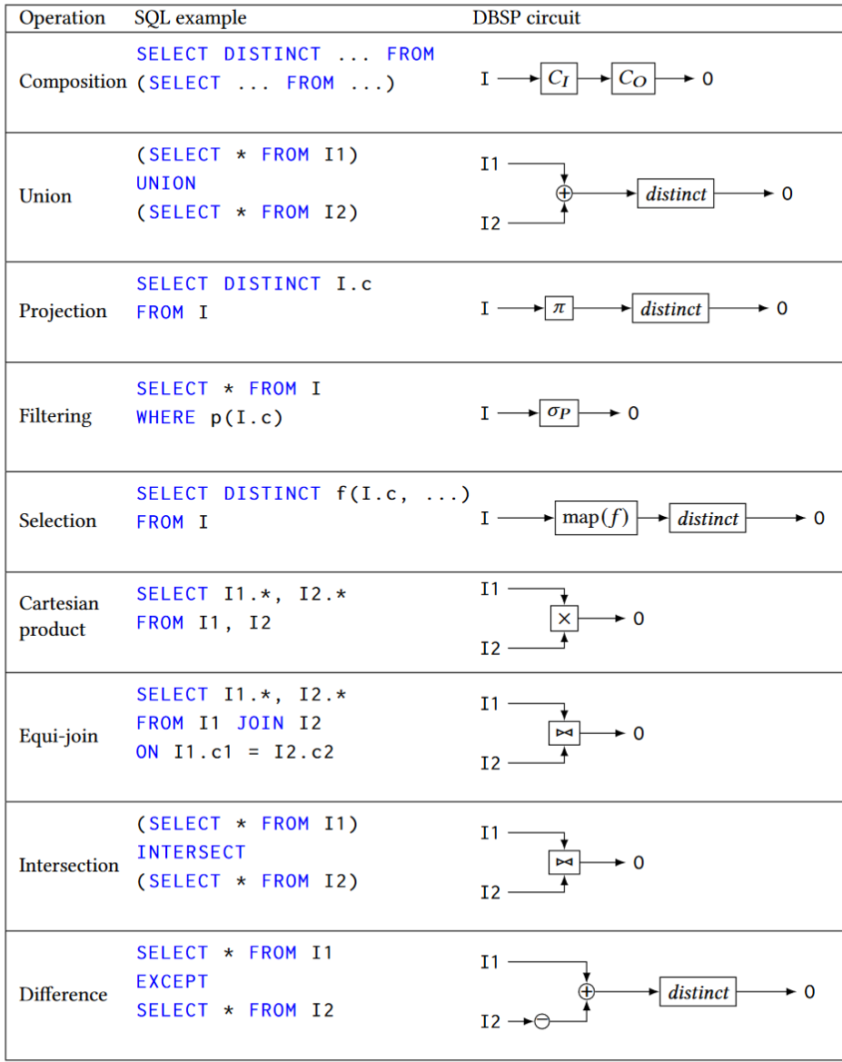
Relational algebra using $ℤ$-set operations
Recursively defined on query structure
Many operations require a $distinct$
The other operations are all linear or bilinear

Slide 15
Incremental view maintenance recipe:
Translate recursively a DB query into a circuit $Q$ on $ℤ$-sets
1.5 Eliminate some distinct calls
Lift circuit to compute on streams: $↑Q$
Build incremental version of lifted circuit:
$${(↑Q)}^{Δ}≝D∘↑Q∘I$$
Optimize $Q^{Δ}$:
$$(Q{∘R)}^{Δ}=Q^{Δ}∘R^{Δ}$$

Slide 16
New stuff starts now!

Slide 17
The ring of weights ($ℤ)$
The multiplication of $ℤ$ shows up in the join implementation …
… where weights of matching keys are multiplied
That’s why joins are bilinear (because $×$ distributes over $+$)

Slide 18
Additional SQL operations
Map (select)
Group-by (nested relations)
Flatmap
Aggregation
Order-by: not a particularly efficient model in DBSP

Slide 19
map_keys(f)
Generalization of SQL SELECT
Given $f:A→B$ the operator map_keys$\left(f\right):ℤ\left[A\right]→ ℤ[B]$ is: map_keys$\left(f\right)\left(i\right)=\sum_{x∈i}{i\left[x\right]⋅f(x)}$
Apply $f$ to each key and “weigh” the result
map_keys$(f)$is linear for any function $f$
Weight of $x$

Slide 20
Groupings
A grouping maps a key to a $ℤ$-set: $K→ℤ\left[A\right]$
Given a key, return a $ℤ$-set
This structure is $ℤ\left[A\right]\left[K\right]$
This is a mathematical group!
Weight
Key | Z-set
K1
K2
K3

Slide 21
Group-by
Given a type of keys $K$ and a function $k: A→K$, groupby$\left(k\right): ℤ\left[A\right]→ℤ\left[A\right]\left[K\right]$ builds a grouping from a $ℤ$-set
groupby is a linear function!
Each tuple in the input delta will affect only one grouping
So ($↑$groupby)$Δ =$ ($↑$groupby)

Slide 22
flatmap_keys
Given $f:A→ℤ[B]$, define flatmap_keys$\left(f\right):ℤ\left[A\right]→ ℤ[B]$ as: flatmap_keys$\left(f\right)\left(i\right)≝\sum_{x∈i}{i\left[x\right]⋅f(x)}$
flatmap_keys is linear for any $f$!
Substitute$ℤ[B][K]$ for $A$, and id: $ℤ\left[B\right]→ ℤ[B]$ for$f$
flatmap_keys(id):$ℤ\left[B\right]\left[K\right]→ℤ[B]$is the right-inverse of group-by
Weight of $x$

Slide 23
Aggregation
Aggregation functions such as weighted SUM and COUNT are linear functions $ℤ\left[ℝ\right]→ℝ$!
$a_{SUM}(s)=\sum_{x∈s}{x×s\left[x\right]}$
(But not linear as functions $ℤ\left[ℝ\right]→ℤ[ℝ]$!)
SELECT SUM(c) FROM I
makeset converts a $ℝ$scalar into a singleton $ℤ$-set
makeset(5) = $\{ 5↦1 \}$
makeset is not linear, but it is not expensive to incrementalize

Slide 24
Non-linear aggregations
E.g., min, max
… or their generalization, top-K
These are not linear on a group structure (they are linear on a monoid… but can’t handle negation)
Implemented using the “brute force” formula:
$${(↑Q)}^{Δ}= D∘(↑Q)∘I$$
The integral is there to “remember” the full set
Can be built efficiently (log work in $|I|$) using a priority queue

Slide 25
Group-By + Aggregate
The composition of
Group-by
map_weights(aggregate)
map_weights applies a function to each grouping
Not to be confused with map_keys from before
Linear if the aggregate function is linear

Slide 26
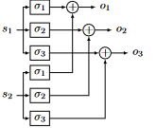
Parallelization
Join on two threads
Volcano “exchange” operator (from 2 threads to 3 threads)

Slide 27
Outline
Recap: streaming and incremental computations
SQL in DBSP
Streaming queries in DBSP
Datalog in DBSP

Slide 28
Convolutions
Window-based computation
Window is defined by the input transactions (not by the contents of the data stream)

Slide 29
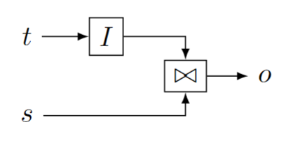
Streaming joins
$t$ are changes to a table
$s$ is a stream
Table $I(t)$ is joined with every stream value in $s$
$o$ is also a stream

Slide 30
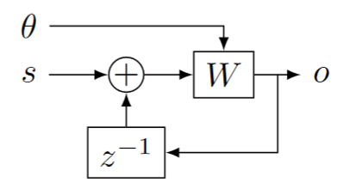
Streaming window queries
$θ$ is a stream of wall-clock values (time)
$s$ is a stream of timestamped data
$W$ window function, filters data in $s$ based on timestamp and time

Slide 31
Alternative window definition
In each transaction
$A$ = what is added
$S$ = what is subtracted from window

Slide 32
Outline
Recap: streaming and incremental computations
SQL in DBSP
Streaming queries in DBSP
Datalog in DBSP

Slide 33
Datalog rules
Rule head
Rule body
sibling(x, y) :- parent(z, x), parent(z, y).
Head relation = circuit output
Relations in body = circuit inputs
Rule body = circuit contents
Conjunctions in rule body = edges in circuit
Turnstyle = projection
Compiled to
proj
sibling
parent

Slide 34
Negation
Stratified: non-recursive
Implemented as either
Subtraction
Anti-join

Slide 35
Recursive computations
Reach(x, y) :- Edge(x, z), Reach(z, y).
The semantics iterates until convergence
To implement “loops” we introduce two new operators:
$δ_{0}$ (enter)
$∫$(exit)

Slide 36
Creating streams from scalars
$$δ_{0}:A→S_{A}$$
$$δ_{0}\left(a\right)\left[t\right]≝\left\{\begin{aligned}a, t=0 \\ &0, t>0\end{aligned}\right.$$
Linear!
scalar
stream
9
9, 0, 0, 0, 0, 0, …

Slide 37
Creating scalars from streams
Only defined for streams that are zero almost everywhere:
$$∫{ :S}_{A}→A$$
$$∫\left(s\right) ≝ \sum_{t≥0}{s\left[t\right]}$$
Linear!
stream
scalar
1, 2, 3, 0, 0, 0, …
6

Slide 38
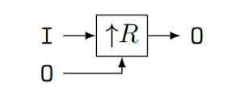
Implementing recursion (1)
Start with a recursive query O = R(I, O) where I and O are relations, and R is a query (on $ℤ$-sets)
Implement R as a (non-recursive) circuit $R:$
Lift to compute on streams:

Slide 39
Implementing recursion (2)
(3) Connect recursive output to input using a delay
(4) Bracket as follows:

Slide 40
Typing
Scalars (not streams!)
Streams

Slide 41
Inputs
a,0,0,0,…
a,a,a,a,…
a

Slide 42
Theorem: this circuit computes fixed-point of $R$
Denote by $S\left(x\right)=λx.R(a, x)$, where $a$ is the value of input I
$o\left[0\right]=R\left(a, 0\right)=S(0)$
$o\left[1\right]=R\left(a, o\left[0\right]\right)= S\left(o\left[0\right]\right)=S\left(S\left(0\right)\right)$
$o\left[k\right]=S^{k+1}\left(0\right)$
If $o[k] = o[k+1]$, then $∀i≥0 o\left[k+i\right]=o[k]$
Starting from $k$ all outputs of $D$ are 0
(But computation may never converge)

Slide 43
Two kinds of streams
Streams were used previously to model time-evolution of a system
Now we use streams to model the execution of a loop
The stream values are consecutive values of the variables in the loop body

Slide 44
Example: Transitive closure
reach(x, y) :- edge(x, y).
reach(x, y) :- edge(x, z), reach(z, y).
edge
reach
edge
join(edge, reach)

Slide 45
Semi-naïve evaluation
$$⇔$$
Cycle rule => correctness of semi-naïve Datalog evaluation

Slide 46
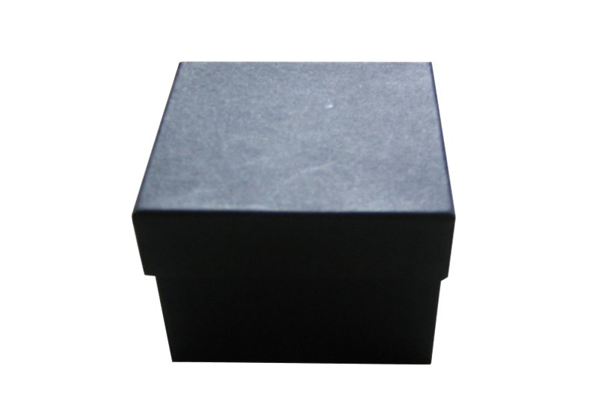
Streaming, incremental, recursive queries
So far we have implemented a recursive non-streaming query
To make it incremental we apply the same recipe as before…
… treating the non-streaming query as a black-box

Slide 47
Lifting and loops
A circuit like implements a query $Q$
Use the definition: ${(↑Q)}^{Δ}≝ D∘\left(↑Q\right)∘I$ by treating the entire circuit like a scalar operator!
Theorem: lifting a circuit is the same a lifting every operator
Works even for loops
$$P$$
$$↑( )$$
$$⇔$$

Slide 48
Streaming incremental recursive queries
Non-incremental streaming
recursive query
Incremental streaming
recursive query
Apply chain and cycle rules

Slide 49
Streams of Streams
$S_{A}$ is defined for any group $A$
$S_{A}$ itself is a group
$S_{S_{A}}$ is a group!

Slide 50
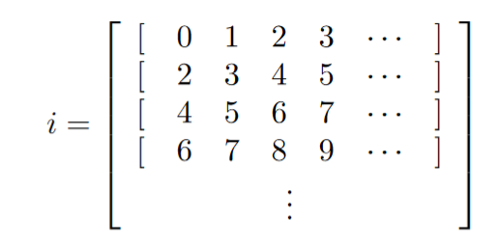
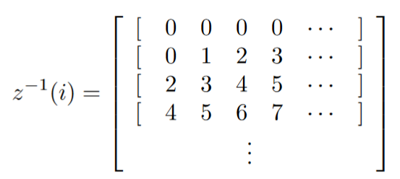
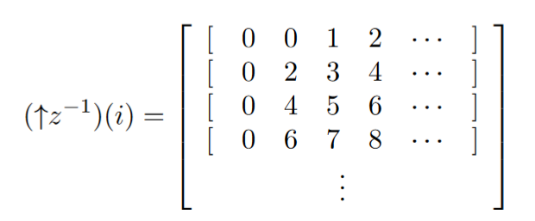
Streams of streams
Loop iterations
The math works out fine
Even for higher dimensions
But it becomes less intuitive
In particular, $z^{−1}$and $↑z^{−1}$ are very different
Transactions
Shift right
Shift down

Slide 51
Example: Transitive, reflexive closure
input relation E(h: Node, t: Node)
output relation R(s: Node, t: Node)
R(x, x) : - E (x, _). R(x, x) : - E (_, x). R(x, y) : - E (x, y). R(x, y) : - E (x, z), R(z, y).

Slide 52
Transitive, reflexive closure: circuit
Non-recursive query
Recursive version

Slide 53
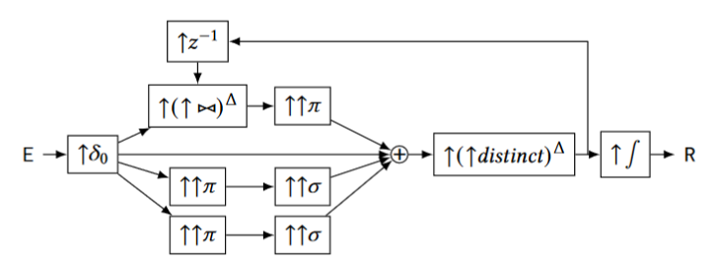
Transitive, reflexive closure: incrementalize
Lifted (streaming)
Incrementalized

Slide 54
Transitive, reflexive closure: optimize
Incrementalized
(previous)
Apply chain, cycle
nonlinear

Slide 55
Transitive, reflexive closure: (bi)linearity
$${\left(↑{\left(↑⋈\right)}^{Δ}\right)}^{Δ}$$
$$↑(↑distinc{t)}^{Δ}$$
$${\left(↑{\left(↑distinct\right)}^{Δ}\right)}^{Δ}$$

Slide 56
Summary
DBSP circuits are a powerful model of streaming computation
Four operators:
$z^{−1}, ↑$: used for non-recursive queries
$δ_{0}, ∫$: used for fixed-point computations
Recipe for incremental view maintenance:
Translate a query into a non-recursive circuit $Q$
Convert recursive queries into fixed-point cycles
Build incremental version of lifted circuit:
$${(↑Q)}^{Δ}≝D∘↑Q∘I$$
Optimize $Q^{Δ}$:
$$(Q{∘R)}^{Δ}=Q^{Δ}∘R^{Δ}$$

