Slide 1
DBSP: Streaming Incremental Computation
Mihai Budiu, Leonid Ryzhyk - VMWare Research
Frank McSherry – Materialize.io
Val Tannen – University of Pennsylvania
May 18, 2022
Databricks

Slide 2
Embrace change!

Slide 3
A success story: VMware Skyline Proactive Intelligence
Identifying and resolving potential issues before they occur
VMware cloud service
https://www.vmware.com/support/services/skyline.html
Supports 8 different VMware products
Expert-written rules detect and report issues (e.g., misconfigurations)
Customer cloud
Skyline
service
DB & UI
configs
upgrades
telemetry
issues
Browse problems

Slide 4
Query execution in Skyline
1000+ queries
Issues?
Data (JSON)
To DB/UI
Horizontally partitioned across tenants.
Consumes JSON (tens of MB/doc)
Analyzes data in flight (no DB read/write)

Slide 5
Scalability
Four generations of the system built since 2017
First 3 use traditional database technologies
Non-incremental cost is O(|data| $×$ |queries|)
Incremental cost is O(|change| $×$ |queries|)
Incremental engine

Slide 6
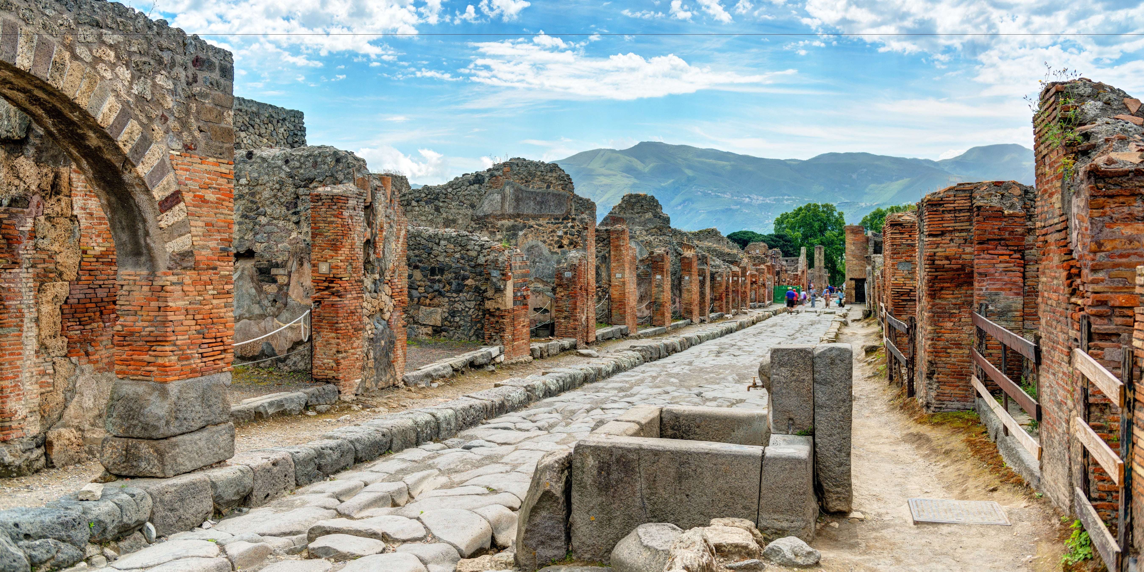
Brief History
Differential Dataflow (DD): a framework for incremental computation (Murray, McSherry, et al, SOSP 2013) https://github.com/TimelyDataflow/differential-dataflow
Differential Datalog (DDlog): a programming language for incremental computation (Vmware Research, 2019) https://github.com/vmware/differential-datalog/ DDlog is the analytics engine in Skyline; build on DD
DBSP: formalize Differential Datalog (2021) https://github.com/vmware/database-stream-processor, https://arxiv.org/abs/2203.16684

Slide 7
Outline
Incremental computation
Streaming computations
Optimizing incremental computations
Implementing queries

Slide 8
What is incremental computation?
Consider a program $Q$
Change $i$ “slightly”
In general, this is hard to even define precisely
$$i$$
$$Q$$
$$o$$
reuse
$$i+Δi$$
$$Q$$
$$o+Δo$$

Slide 9
Databases
$$i+Δi$$
$$Q$$
$$o+Δo$$
Databases have a natural notion of “changes”
$Q$ is a query
$i$ is a set of tables
$Δi$ is a transaction (“diff”)
Example of a single change:
Table people: +(Bob, 5), -(Amy, 2)
Table address: +(Bob, San Jose), -(Amy, Fremont), +(John, Sunnyvale)
Usually $\left|Δi\right|≪|i|$ and $\left|Δo\right|≪|o|$

Slide 10
The incremental version of a query
Consider a program $Q$
$$i$$
$$Q$$
$$o$$
Definition: The incremental version of $Q$ is a program $Q^{Δ}$, computing directly on changes:
$${Δi}_{0}$$
$${Δi}_{1}$$
$${Δi}_{2}$$
$${Δi}_{3}$$
…
$$Q^{Δ}$$
$$Δo_{0}$$
$$Δo_{1}$$
$$Δo_{2}$$
$$Δo_{3}$$
…

Slide 11
Incremental queries are streaming systems
$${Δi}_{0}$$
$${Δi}_{1}$$
$${Δi}_{2}$$
$${Δi}_{3}$$
…
$$Q^{Δ}$$
$$Δo_{0}$$
$$Δo_{1}$$
$$Δo_{2}$$
$$Δo_{3}$$
…
state
$Q^{Δ}$ is a streaming system:
it runs forever
it has internal state (even if $Q$ is stateless)

Slide 12
Differential Datalog Compiler
Input: query $Q$ (written in Datalog)
Output: an implementation of $Q^{Δ}$ (written in Rust)
https://github.com/vmware/differential-datalog/
DDlog
program
DDlog compiler
Rust
Program
$$Q^{Δ}$$
$$Q$$

Slide 13
Input changes
$$i_{0}$$
$$i$$
$$i_{2}$$
$$i_{3}$$
…
$$Q$$
$$o_{0}$$
$$o_{1}$$
$$o_{2}$$
$$o_{3}$$
…
$${Δi}_{0}$$
$${Δi}_{1}$$
$${Δi}_{2}$$
$${Δi}_{3}$$
…
$$Q^{Δ}$$
$$Δo_{0}$$
$$Δo_{1}$$
$$Δo_{2}$$
$$Δo_{3}$$
…
$i_{0} =Δi_{0}$
$i_{1}=i_{0}+Δi_{1}=Δi_{0}+Δi_{1}$
$i_{n}=i_{n−1}+Δi_{n}=Δi_{0}+Δi_{1}+…+Δi_{n}=\sum_{k≤n}{Δi_{k}}$
$i$ is the prefix sum of $Δi$
In general, $o_{n}=Q\left(i_{n}\right)=Q\left(\sum_{k≤n}{Δi_{k}}\right)$
$+$ (plus) = “applying a diff”

Slide 14
Output changes
$$i_{0}$$
$$i_{1}$$
$$i_{2}$$
$$i_{3}$$
…
$$Q$$
$$o_{0}$$
$$o_{1}$$
$$o_{2}$$
$$o_{3}$$
…
$${Δi}_{0}$$
$${Δi}_{1}$$
$${Δi}_{2}$$
$${Δi}_{3}$$
…
$$Q^{Δ}$$
$$Δo_{0}$$
$$Δo_{1}$$
$$Δo_{2}$$
$$Δo_{3}$$
…
$o_{0}=Q(i_{0})$
${Δo}_{0}=o_{0}$
$Δo_{1}=o_{1}−o_{0}$
$Δo_{n}=o_{n}−o_{n−1}$
$−$ (minus) = “computing the diff”

Slide 15
Strawman implementation
$${Δi}_{0}$$
$${Δi}_{1}$$
$${Δi}_{2}$$
$${Δi}_{3}$$
…
$$Q^{Δ}$$
$$Δo_{0}$$
$$Δo_{1}$$
$$Δo_{2}$$
$$Δo_{3}$$
…
$Δo_{n}=o_{n}−o_{n−1}= Q\left(\sum_{k≤n}{Δi_{k}}\right)−Q(\sum_{k<n}{Δi_{k}})$
This is very inefficient, but it is correct.
We now have a definition of what we need to achieve, and in the rest of the talk, we will improve this implementation.

Slide 16
Outline
Incremental computation
Streams
Optimizing incremental circuits
Implementing queries in DBSP

Slide 17
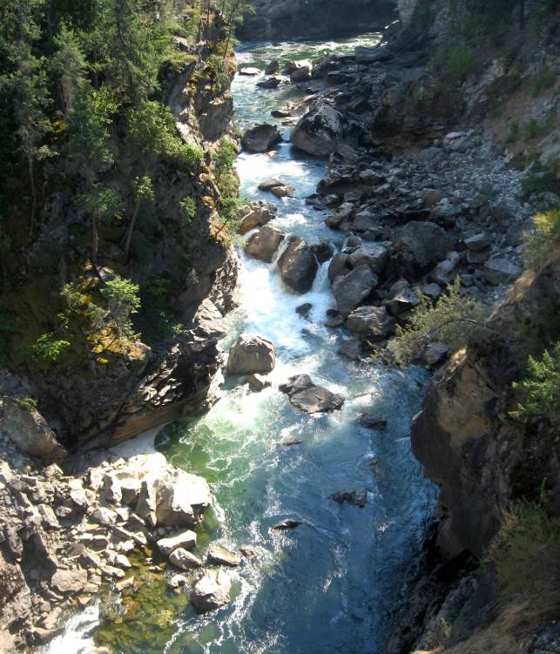
Streams
A stream is an infinite vector of values, e.g.:
$s =$ …
For this example: $s[0] = 0$, $s\left[1\right]=1$, …
$S_{A}$ = stream with values of type $A$
0
1
2
1
0
-1
-2
-1
time

Slide 18
Stream operators
Computations that consume and produce streams:$Q:S_{A}→ S_{B}$
Operators can have multiple inputs: $T:S_{A_{0}}×S_{A_{1}}→S_{B}$
Streams = arrows, operators = boxes
Operators can be implemented as simple dataflow machines
$$i_{0}$$
$$i_{1}$$
$$i_{2}$$
…
$$Q$$
$$o_{0}$$
$$o_{1}$$
$$o_{2}$$
…
…
$$T$$
…
…

Slide 19
Lifting
Convert a function $f:A→B$ into a function $↑f:S_{A}→S_{B}$
Apply the function to each stream value
$$a$$
$$b$$
$$c$$
…
$$↑f$$
$$f(a)$$
$$f(b)$$
$$f(c)$$
…

Slide 20
Streaming queries
$$i_{0}$$
$$i_{1}$$
$$i_{2}$$
$$i_{3}$$
…
$$↑Q$$
$$o_{0}$$
$$o_{1}$$
$$o_{2}$$
$$o_{3}$$
…
$${Δi}_{0}$$
$${Δi}_{1}$$
$${Δi}_{2}$$
$${Δi}_{3}$$
…
$$({↑Q)}^{Δ}$$
$$Δo_{0}$$
$$Δo_{1}$$
$$Δo_{2}$$
$$Δo_{3}$$
…
In our previous diagram we should have used the lift $↑$ symbol
Not all streaming operators are lifted operators
(in fact, ${\left(↑Q\right)}^{Δ}$ is not a lifted operator)

Slide 21
Lifting binary functions
Apply a binary function pointwise on two streams:
Example:
$$a$$
$$b$$
$$c$$
…
$$↑T$$
$$T(a,d)$$
$$T(b,e)$$
$$T(c,f)$$
…
$$d$$
$$e$$
$$f$$
…
$$1$$
$$2$$
$$3$$
…
$$↑+$$
5
7
$$9$$
…
$$4$$
$$5$$
$$6$$
…

Slide 22
Delay ($z^{−1}$ )
Output is input delayed by one time unit
First value is pre-defined “0” (zero)
(The name $z^{−1}$ comes from Digital Signal Processing)
This is the only primitive operator with internal state
$$a$$
$$b$$
$$c$$
$$d$$
…
$$z^{−1}$$
$$0$$
$$a$$
$$b$$
$$c$$
…

Slide 23
Chaining operators into circuits
Dataflow machines (function composition)
$$o=C(B(A\left(i_{1}\right), D(i_{2}))$$
$$i_{1}$$
$$A$$
$$B$$
$$C$$
o
$$i_{2}$$
$$D$$

Slide 24
Circuit equivalence
Two circuits are equivalent iff they compute the same result given the same inputs
Function composition is associative => these circuits are equivalent for any deterministic streaming operators $A, B, C$
$$A$$
$$B$$
$$C$$
$$⇔$$
$$A$$
$$B$$
$$C$$

Slide 25
Differentiation
What does this circuit compute?
$o\left[t\right]=s\left[t\right]–s\left[t−1\right]$
$o\left[0\right]=s\left[0\right]$
o
Denote this circuit by $D:S_{A}→S_{A}$
o is the stream of changes of s
$$1$$
$$2$$
$$3$$
$$2$$
…
$$D$$
$$1$$
$$1$$
$$1$$
$$−1$$
…
stream of changes

Slide 26
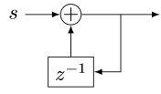
Integration
Denote this operator by $I: S_{A}→S_{A}$
If s is a stream of changes…
… then o is the original stream
What does this circuit compute?
This looks weird: o is recursively defined!
But it is well-defined:
$o\left[0\right]=s\left[0\right]+0$
$o[t] =s[t] + o[t−1]$
Has a unique solution: $o\left[t\right]=\sum_{k=0}^{t}{s\left[t\right]}$
o
$$1$$
$$1$$
$$1$$
$$−1$$
…
$$I$$
$$1$$
$$2$$
3
$$2$$
…
stream of changes

Slide 27
$I$ and $D$
$I$ and $D$ can be defined in terms of $+$, $−$, and $z^{−1}$
They are stream operators
The contain internal state
From now on treat them as black boxes
$$i_{0}$$
$$i_{1}$$
$$i_{2}$$
$$i_{3}$$
…
$$D$$
$$Δi_{0}$$
$$Δi_{1}$$
$$Δi_{2}$$
$$Δi_{3}$$
…
stream of changes
$$Δi_{0}$$
$$Δi_{1}$$
$$Δi_{2}$$
$$Δi_{3}$$
…
$$I$$
$$i_{0}$$
$$i_{1}$$
$$i_{2}$$
$$i_{3}$$
…
stream of changes

Slide 28
Theorem

Slide 29
Fundamental Equation of Incremental Computation
$${Δi}_{0}$$
$${Δi}_{1}$$
$${Δi}_{2}$$
$${Δi}_{3}$$
…
$$({↑Q)}^{Δ}$$
$$Δo_{0}$$
$$Δo_{1}$$
$$Δo_{2}$$
$$Δo_{3}$$
…
$$Δi_{0}$$
$$Δi_{1}$$
$$Δi_{2}$$
$$Δi_{3}$$
…
$$I$$
$$i_{0}$$
$$i_{1}$$
$$i_{2}$$
$$i_{3}$$
…
stream of changes
$$↑Q$$
$$o_{0}$$
$$o_{1}$$
$$o_{2}$$
$$o_{3}$$
…
$$D$$
$$Δo_{0}$$
$$Δo_{1}$$
$$Δo_{2}$$
$$Δo_{3}$$
…
stream of changes
$$I$$
$$↑Q$$
D
$$⇔$$
$$({↑Q)}^{Δ}$$
This is the same as the strawman implementation!

Slide 30
Non-lifted operators
$$I$$
$$↑Q$$
D
$$⇔$$
$$({↑Q)}^{Δ}$$
This applies even if Q is not a lifted operator:
$$I$$
$$Q$$
D
$$⇔$$
$$Q^{Δ}$$

Slide 31
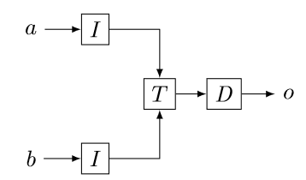
Multiple inputs
$$T^{Δ}$$

Slide 32
All databases are streaming databases!
Consider a database $DB$, a set of tables
A committed transaction is a change to $DB$
The set of linearized transactions define $T,$ a stream of changes to $DB$
$T[t]$is the $t$-th transaction
$DB$ is a stream of database snapshots
$DB[t]$ is the contents of the database after $t$ transactions have been executed
$DB[t] = I(T(t))$ – the integral of the transaction stream
$$T_{0}$$
$$T_{1}$$
$$T_{2}$$
$$T_{3}$$
…
$$I$$
$${DB}_{0}$$
$${DB}_{1}$$
$${DB}_{2}$$
$${DB}_{3}$$
…

Slide 33
Views
Let $Q$ be a query defining a view $V$ as a function of the database, e.g.:
CREATE VIEW V AS SELECT * FROM T WHERE Age >= 10
$V[t]=Q\left(DB[t]\right)$
$V$ is a stream of view snapshots:
$$V= ↑Q(DB)$$
$$↑Q$$
$$V_{0}$$
$$V_{1}$$
$$V_{2}$$
$$V_{3}$$
…
Versions of $V$
Versions of $DB$
$${DB}_{0}$$
$${DB}_{1}$$
$${DB}_{2}$$
$${DB}_{3}$$
…

Slide 34
Incremental view maintenance
The incremental maintenance of $V$ is performed by the operator
${(↑Q)}^{Δ}= D∘(↑Q)∘I$
$${(↑Q)}^{Δ}$$
$$T_{0}$$
$$T_{1}$$
$$T_{2}$$
$$T_{3}$$
…
$$I$$
$$↑Q$$
D
$$ΔV_{0}$$
$$ΔV_{1}$$
$$ΔV_{2}$$
$$ΔV_{3}$$
…
Changes to $DB$
Changes to $V$
$$V_{0}$$
$$V_{1}$$
$$V_{2}$$
$$V_{3}$$
…
Versions of $V$
Versions of $DB$
$${DB}_{0}$$
$${DB}_{1}$$
$${DB}_{2}$$
$${DB}_{3}$$
…

Slide 35
Traditional definition:
$$T_{0}$$
$$T_{1}$$
$$T_{2}$$
$$T_{3}$$
…
$$I$$
$$↑Q$$
$$V_{0}$$
$$V_{1}$$
$$V_{2}$$
$$V_{3}$$
…
Changes to $DB$
Versions of $V$
Our definition:
$${(↑Q)}^{Δ}$$
$$T_{0}$$
$$T_{1}$$
$$T_{2}$$
$$T_{3}$$
…
$$I$$
$$↑Q$$
D
$$ΔV_{0}$$
$$ΔV_{1}$$
$$ΔV_{2}$$
$$ΔV_{3}$$
…
Changes to $V$
$$V_{0}$$
$$V_{1}$$
$$V_{2}$$
$$V_{3}$$
…
Versions of $DB$
$${DB}_{0}$$
$${DB}_{1}$$
$${DB}_{2}$$
$${DB}_{3}$$
…
This seemingly minor difference has huge consequences

Slide 36
Traditional definition:
$$T_{0}$$
$$T_{1}$$
$$T_{2}$$
$$T_{3}$$
…
$$I$$
$$↑Q$$
$$V_{0}$$
$$V_{1}$$
$$V_{2}$$
$$V_{3}$$
…
Changes to $DB$
$$T_{0}$$
$$T_{1}$$
$$T_{2}$$
$$T_{3}$$
…
$$I$$
$$↑Q$$
D
$$ΔV_{0}$$
$$ΔV_{1}$$
$$ΔV_{2}$$
$$ΔV_{3}$$
…
Changes to $DB$
Changes to $V$
This is the right API
It is essentially impossible to get changes from a DB (triggers, logs, no atomicity)
This API is composable

Slide 37
Embrace change!

Slide 38
Outline
Incremental computation
Streams
Optimizing incremental circuits
Implementing queries in DBSP

Slide 39
Commutative Groups
A group G is a set with
Associative (and commutative) plus +
Neutral element zero 0
Inverse negate –
The following results are true for streams over a group: $S_{G}$
We will see later how we can apply this to relational databases

Slide 40
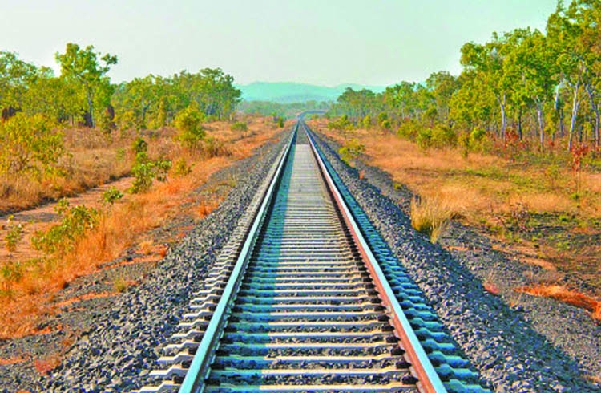
Linear operators
Definition: For groups $G, H$, a unary stream operator $Q:S_{G}→S_{H}$ is linear if:
$$Q\left(s+t\right)=Q\left(s\right)+ Q\left(t\right)$$
(Used $+$ instead of $↑+$).
$−$, $I$, $D$, $z^{−1}$ are linear

Slide 41
Bilinear operators
Definition: A binary stream operator $⋈:S_{G}×S_{H}→S_{J}$ is bilinear if it distributes over stream addition:
$$\left(s+t\right)⋈u=(s⋈u)+(t⋈u)$$
$$s⋈\left(u+v\right)=(s⋈u)+(s⋈v)$$
Examples: lifted multiplication: $T\left(s,u\right)\left[t\right]=s\left[t\right]⋅u[t]$, joins

Slide 42
Linear operators
Theorem: For a linear stream operator $Q$ we have $Q=Q^{Δ}$
(most operators used in DB queries are linear)
Why is this better?
Assume $\left|T\left[t\right]\right|≪|DB[t]|$
Original:
Optimized:
A speedup of $O(\left|DB\right|/|T|)$
$$T_{0}$$
$$T_{1}$$
$$T_{2}$$
$$T_{3}$$
…
$$I$$
$$Q$$
D
$$ΔV_{0}$$
$$ΔV_{1}$$
$$ΔV_{2}$$
$$ΔV_{3}$$
…
$${DB}_{0}$$
$${DB}_{1}$$
$${DB}_{2}$$
$${DB}_{3}$$
…
$$T_{0}$$
$$T_{1}$$
$$T_{2}$$
$$T_{3}$$
…
$$Q$$
$$ΔV_{0}$$
$$ΔV_{1}$$
$$ΔV_{2}$$
$$ΔV_{3}$$
…

Slide 43
Example of a linear query
CREATE VIEW V AS SELECT * FROM T WHERE Age >= 10
You don’t need to know what’s in T to compute the changes to V
(Such queries can compute independently over shards)
If you change T by adding $Δ$T…
…this (same) query computes $Δ$V:
SELECT DISTINCT * FROM $Δ$T WHERE Age >= 10

Slide 44
The chain rule
$$(Q_{2}{∘Q_{1})}^{Δ}=Q_{2}^{Δ}∘Q_{1}^{Δ}$$
Proof by pictures:
We can incrementalize a complex query by incrementalizing each component independently
For linear operators: $(Q_{2}{∘Q_{1})}^{Δ}=Q_{2}^{Δ}∘Q_{1}^{Δ}=Q_{2}∘Q_{1}$
$$⇔$$
$$⇔$$
$$⇔$$

Slide 45
Bilinear operators
join, intersection, Cartesian product
From distributivity:$Δ\left(A×B\right)=\left(A×ΔB\right)+\left(ΔA×B\right)+\left(ΔA×ΔB\right)$
Speed-up is $O(\min\left(\left|ΔA\right|/\left|A\right|, \left|ΔB\right|/\left|B\right|\right))$
$$⇔$$

Slide 46
Internal state
Incremental lifted join circuit
The state inside $I$ is as large as the whole input (integral of all changes)
However, the work of the incremental join operator at time $t$ is just $O(|a[t]|)$ --- and not $O(|I(a[t])|)$

Slide 47
Outline
Incremental computation
Streams
Optimizing incremental circuits
Implementing Queries in DBSP

Slide 48
Computing on tables
SQL queries are functions from tables to tables: $$Q:T_{0}×…×T_{n}→T$$
T
Query
Query result
Name | Age
Mike | 10
John | 12
Amy | 8
Chris | 10
Name | Age
Mike | 10
John | 12
Chris | 10
SELECT * FROM T WHERE Age >= 10

Slide 49
We need a group $G$!
Our results work for $Q:S_{G}→S_{G}$
However, DB tables (sets, multisets) are not groups
E.g., there is no table negation
Generalize tables to obtain a commutative group

Slide 50
$ℤ$-sets (or $ℤ$-relations)
Generalize sets so that each element has an integer weight
Weight can be positive, zero, or negative
Name | Age | Weight
Mike | 10 | 1
John | 12 | 3
Amy | 8 | -1
Chris | 10 | 2
tuples

Slide 51
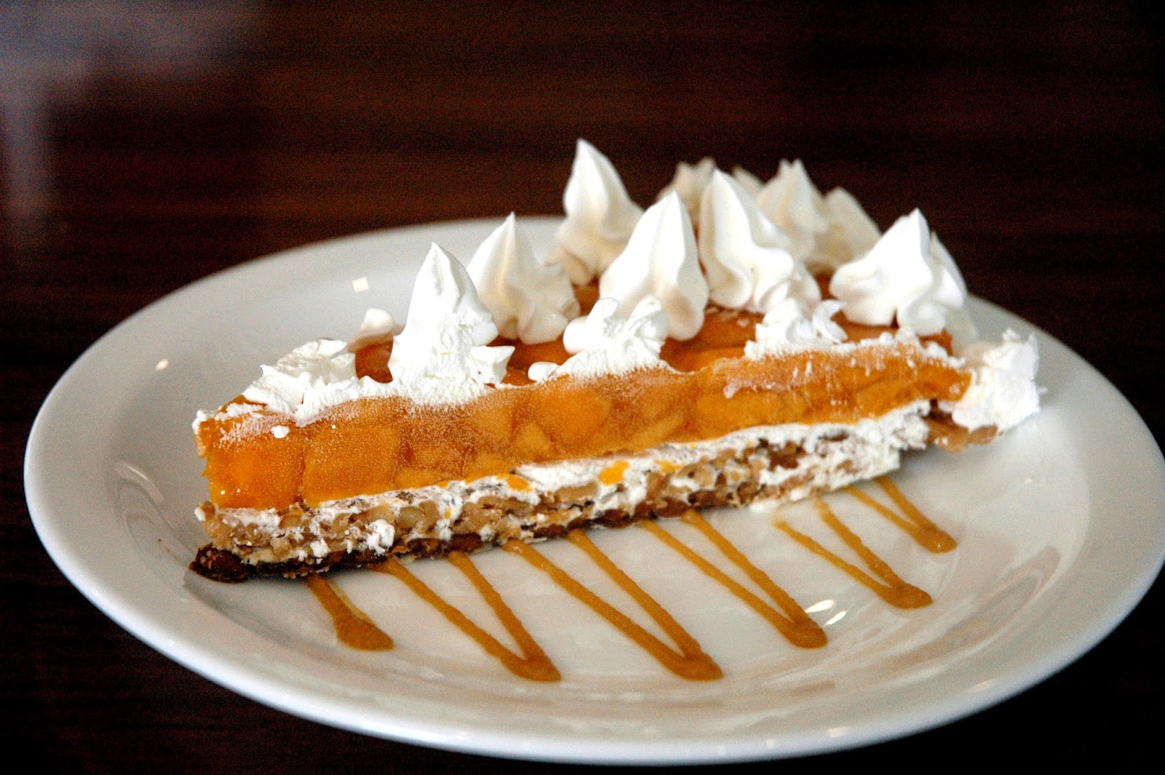
$ℤ$-sets are yummy!
Can represent both tables and changes to tables
Positive weights = elements added
Negative weights = elements removed
Generalize sets and multisets
Classic DB table = $ℤ$-set where all weights are 1
Form a commutative group (because $ℤ$ is a group)
Addition just adds the weights of tuples
Zero is an empty table
Negation just negates all weights

Slide 52
Example: $ℤ$-set addition
Name | Weight
Mike | 1
John | 3
Amy | -1
Chris | 2
Name | Weight
Mike | -1
Dan | 1
Chris | 1
Name | Weight
Dan | 1
John | 3
Amy | -1
Chris | 3
+
=

Slide 53
The distinct operator
“Converts” a $ℤ$-set into a set
$distinct\left(r\right)\left[t\right]= \left\{\begin{aligned}1 if r\left[t\right]>0 \\ 0 otherwise\end{aligned}\right.$
Name | Weight
Dan | 1
John | 3
Amy | -1
Chris | 3
Name | Weight
Dan | 1
John | 1
Chris | 1
$$distinct\left( \right)=$$

Slide 54
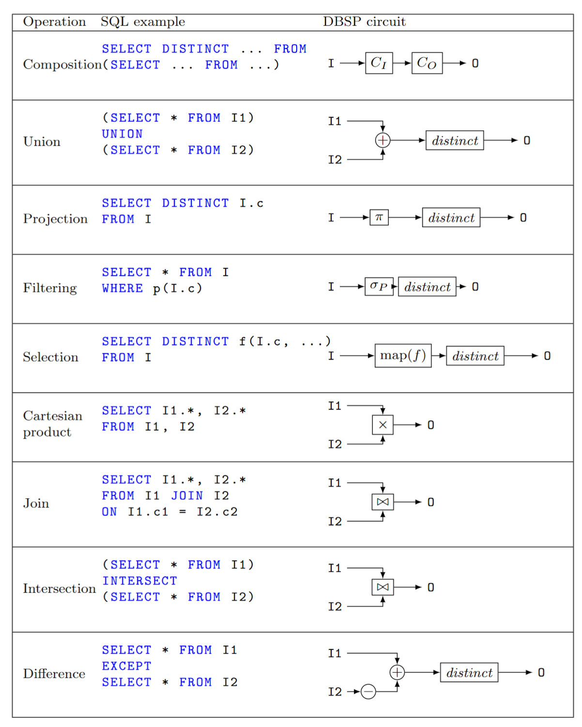
Relational algebra on $ℤ$-sets
Many operations require a $distinct$
All other ops are linear or bilinear
Many $distinct$s can be removed
${\left(↑distinct\right)}^{Δ}$ can be efficient

Slide 55
Recipe for incremental view maintenance
Translate a DB query into a circuit $Q$
Lift circuit to compute on streams: $↑Q$
Build incremental version of circuit:
$$(↑{Q)}^{Δ}≝D∘(↑Q)∘I$$
4. Optimize $Q^{Δ}$:
$$(S{∘R)}^{Δ}=S^{Δ}∘R^{Δ}$$

Slide 56
Example
CREATE VIEW V AS SELECT DISTINCT a.x, b.y FROM ( SELECT t1.x , t1.id FROM t1 WHERE t1.a > 2 ) a JOIN ( SELECT t2.id , t2.y FROM t2 WHERE t2.s > 5 ) b ON a.id = b.id
Inputs and outputs are collections, not streams

Slide 57
Example: Remove distinct calls
⬄
⬄
⬄

Slide 58
Example: Lift and incrementalize
Inputs and outputs are streams
Inputs and outputs are streams of changes

Slide 59
Example: optimize incremental circuit
Linearity
Expand join and distinct

Slide 60
Other operations we can model
Nested collections
Group-by (linear!)
Flatmap (linear!)
Aggregation (some aggregations, such as sum and count, are linear)
Recursive queries (Datalog with stratified negation)
Graph queries, e.g., graph reachability
Streaming joins (next slide)
Relational while queries
We don’t have a characterization of the power of DBSP

Slide 61
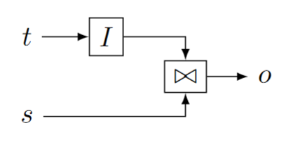
Streaming joins
$t$ are changes to a table
$s$ is a stream
Table $I(t)$ is joined with every stream value in $s$
$o$ is also a stream

Slide 62
Convolutions (window-based aggregates)

Slide 63
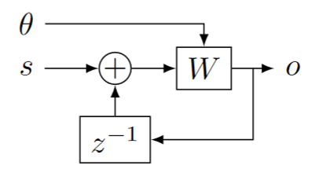
Streaming window queries
$θ$ is a stream of wall-clock values (time)
$s$ is a stream of timestamped data
$W$ window function, filters data in $s$ based on timestamp and time

Slide 64
Conclusion

Slide 65
Extra slides

Slide 66
Recursion
Operator producing stream $(i, 0, 0, 0, …)$ from input $i$
$$o[0] =Q(i)$$
$$o\left[t\right]= Q\left(o\left[t−1\right]\right)=Q^{t+1}\left(i\right)$$
This circuit computes the fixpoint of $Q$
$$o$$
$$∫$$
“Loop termination” operator

Slide 67
Definition of Differential Datalog
The Differential Datalog compiler
receives as input a query $Q$, written in Datalog
Produces as output an implementation of $Q^{Δ}$, written in Rust
stream of input changes
DDLog
program
DDlog compiler
Rust
Program
$$Q^{Δ}$$
Rust compiler
Native library
$$Q$$
stream of output changes
Differential dataflow
library

Slide 68
We’re only getting started!
Core DBSP library
Parallel and distributed execution
Formal verification
Persistence
Fault-tolerance
Load-balancing
Runtime queries
Cloud service
Integration in existing systems (SQL, Spark, Rust, etc.)
Applications

Slide 69
Related work
Incremental View Maintenance
Streaming Databases
Streaming languages
Functional Languages
Category theory
Dataflow machines
Synchronous circuits

Slide 70
The DBSP language
Simple: Four (4) operators
Models both streaming and incremental computations
An algorithm converting an arbitrary DBSP program to an incremental DBSP program
A recipe implementing DB queries in DBSP
https://arxiv.org/abs/2203.16684

Slide 71
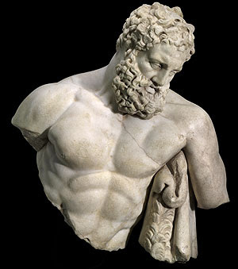
DBSP is powerful
It can model a rich class of database queries:
Relational (select, project, join, union, difference)
Computations on sets, bags, multisets
Nested relations (group-by, flatmap)
Aggregation
Recursion (monotonic and non-monotonic)
Stratified negation
Streaming computations (joins, window aggregates)
Relational while queries
More?
Corollary: we get automatically incremental evaluation for all these
The bold ones are new theoretical results
SQL
Datalog
CQL

Slide 72
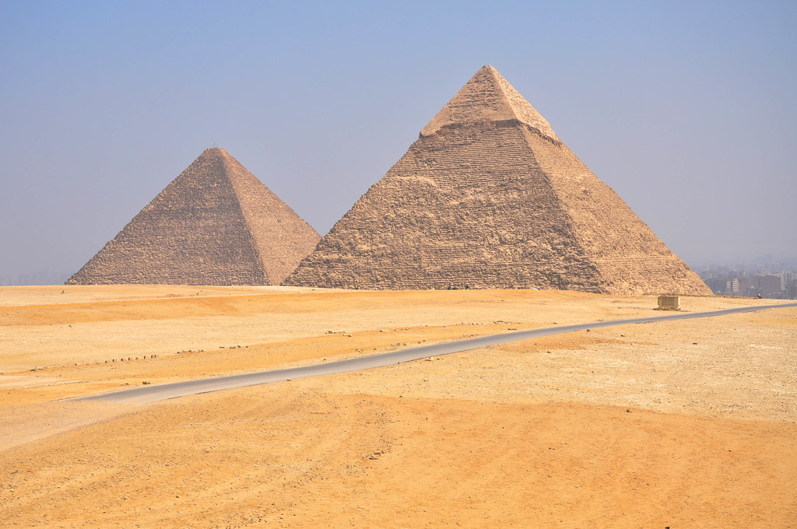
Time-invariant operators
An operator is time-invariant if does not “depend on time”
We only use time-invariant operators
Example which is not time-invariant: $Q\left(s\right)\left[t\right]= s\left[t\right]+ t mod 2$

Slide 73
Causal operators
Emit output[t] before receiving input[t+1]
We only use causal operators

Slide 74
Materialized View Update Problem
We essentially cover this whole space
IEEE Data Engineering Bulletin, 1995

Slide 75
Datalog
Essentially an alternative language to SQL for describing views (Datalog views are always sets – no duplicates allowed)
Differential Datalog (DDlog) is a dialect of Datalog with extra features
CREATE VIEW V AS
SELECT DISTINCT * FROM T
WHERE Age >= 10
V(name, age) :- T(name, age), age >= 10.
SQL
Datalog

Slide 76
Set intersection
SELECT * FROM T1 INTERSECT SELECT * FROM T2
O(x) :- T1(x), T2(x).
This is a disguised JOIN. We will see it soon.

Slide 77
Projection
SELECT Age FROM T
In DDlog:
O(age) :- T(_, age).
The weight of $t$ = sum of weights of all tuples that project to $t$
$$π_{C}\left(m\right)\left[t\right]=\sum_{\begin{aligned}x∈m \\ π_{C\left(x\right)}=t\end{aligned}}{m[x]}$$
$$T$$
$${↑π}_{C}$$
$$distinct$$
$$V$$
Name | Age | Weight
Mike | 10 | 1
John | 12 | 3
Amy | 8 | -1
Chris | 10 | 2
Age | Weight
10 | 1+2
12 | 3
8 | -1
SELECT Age

Slide 78
Translating a DDlog rule
Rule head
Rule body
RelationHead :- RelationTerm0, not RelationTerm1.
Head relation = circuit output
Relations in body = circuit inputs
Rule body = circuit contents
Edges in circuit = conjunctions in rule body
Turnstyle = projection
Compiled to
RelationTerm0
proj
RelationHead
RelationTerm1

Slide 79
Multiset union (can have duplicates)
CREATE VIEW V AS SELECT * FROM T1 UNION ALL SELECT * FROM T2
From now on I will omit the “CREATE VIEW” part.
T1
+
V
T2

Slide 80
Set union (no duplicates)
SELECT * FROM T1 UNION SELECT * FROM T2
V(x) :- T1(x). V(x) :- T2(x).
SQL
Datalog
T1
+
$$↑distinct$$
V
T2

Slide 81
Set difference
SELECT * FROM T1 EXCEPT SELECT * FROM T2
V(x) :- T1(x), not T2(x).
T1
+
$$↑distinct$$
V
T2
-
Note: distinct will remove elements with negative weights

Slide 82
Selection (filtering)
SELECT * FROM T WHERE predicate
O(t) :- T(t), predicate(t).
Name | Age | Weight
Mike | 10 | 1
John | 12 | 3
Amy | 8 | -1
Chris | 10 | -2
Name | Age | Weight
Mike | 10 | 1
John | 12 | 3
Chris | 10 | -2
WHERE Age >= 10

Slide 83
Selection (filtering)
SELECT * FROM T WHERE predicate
V(t) :- T(t), predicate(t).
$$σ:ℤ\left[T\right]→ℤ[T]$$
$$σ\left(m\right)[t]=\left\{\begin{aligned}m\left[t\right], if predicate(t) \\ 0, otherwise\end{aligned}\right.$$
$$T$$
$$↑σ$$
V
$σ$ keeps all tuples for which the predicate is true.

Slide 84
Query composition
SELECT … FROM (SELECT … FROM …)
E(y) :- T(x),…. V(z) :- E(y),….
E
Table
$$Q_{1}$$
$$Q_{2}$$
O
Query composition is circuit chaining (function composition).

Slide 85
Cartesian products
V(t1, t2) :- T1(t1), T2(t2).
SELECT T1.*, T2.* FROM T1, T2
Name | Age | Weight
Mike | 10 | 1
John | 10 | 3
Amy | 10 | -1
Chris | 10 | 2
Mike | 12 | 3
John | 12 | 9
Amy | 12 | -3
Chris | 12 | 6
Name | Weight
Mike | 1
John | 3
Amy | -1
Chris | 2
Age | Weight
10 | 1
12 | 3
x
=
Multiply weights.

Slide 86
Cartesian products
V(t1, t2) :- T1(t1), T2(t2).
SELECT T1.*, T1.* FROM T1, T2
$m_{1}∈ℤ\left[T_{1}\right],$ $m_{2}∈ℤ\left[T_{2}\right]$, ($m_{1}×m_{2})\left[\left(t_{1}, t_{2}\right)\right]≝m_{1}\left[t_{1}\right]⋅m_{2}\left[t_{2}\right]$
T1
$$↑×$$
V
T2

Slide 87
(Equi)Joins
SELECT Name, Age FROM T1 JOIN T2 ON T1.Name=T2.Name
O(Name, Age) :- T1(Name, Age), T2(Name, _).
T1
$$↑×$$
$$↑σ$$
V
T2
Cartesian product followed by filtering.

Slide 88
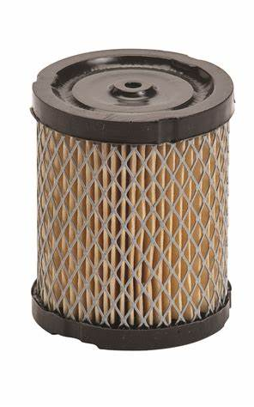
DSP Filters
Most circuits in DSP are composed of linear, time-invariant blocks
These have some very nice mathematical properties
In particular, their output is fully described by their response to an “impulse” (the stream 1,0,0,0…)
Given their impulse response R and an input signal S, the output is R * S – the convolution of R and S
$I$ is an IIR filter – Infinite Impulse Response (1,1,1,1,…)
$D$ is a FIR filter – Finite Impulse Response (1,-1,0,0,….)
However, many of the computations we will need are not linear
So most of the beautiful DSP theory does not apply

Slide 89
Relation to synchronous digital circuits
Combinational logic (acyclic graphs)
“Instantaneous” propagation
Flip-flops or latches (memory elements)
Clocked elements
Remember value from previous clock
This is our delay element $z^{−1}$
Sequential circuits
Combinational logic
All back-edges must go through a latch
clock
input
Combinational
circuit
output
state

Slide 90
Synchronous circuits ideas
The entire state is stored in latches
State summarizes the entire history of the circuit
State = checkpoint.
Optimizations such as retiming can be used to minimize state
Retiming moves around latches without changing the circuit semantics

Slide 91
DBSP vs Differential Dataflow
DBSP is inspired by DD
https://github.com/TimelyDataflow/differential-dataflow
DBSP is much simpler than DD
DD has the notion of “change” built-in
In DBSP the changes are obtained by using $D$ and $I$
DD is more general
DBSP requires that input changes are streamed in time order
In DD changes can be made at any time, not just in time order

Slide 92
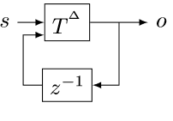
The cycle rule
$$⇔$$
Allows us to recursively incrementalize circuits with feedback
All our circuits are built from:
Sequential composition
Feedback loops
We get a scheme for incrementalizing any circuit

Slide 93
Recursive computations
Reach(x, y) :- Edge(x, z), Reach(z, y).
Very nasty in SQL
The implementation iterates until convergence.
We will introduce two new circuit elements to create (inner) loops.

Slide 94
Creating streams from scalars
An operator that creates a stream from a scalar value
$$δ_{0}:A→S_{A}$$
$$δ_{0}\left(a\right)\left[t\right]≝\left\{\begin{aligned}a, t=0 \\ &0, t>0\end{aligned}\right.$$
scalar
stream
9
9, 0, 0, 0, 0, 0, …

Slide 95
Creating scalars from streams
This operator is only defined for streams that have a finite number of non-zero elements (they are zero almost everywhere, a.e.)
$$∫{ :S}_{A}→A$$
$$∫\left(s\right) ≝ \sum_{t≥0}{s[t]}$$
Add all values in stream. Well-defined if stream is 0 a.e.
stream
scalar
1, 2, 3, 0, 0, 0, …
6

Slide 96
Creating a loop
These two operators are always used in pairs as follows:
Most useful when $Q$ has a recursive definition:
$$o[0] =Q(i)$$
$$o\left[t\right]= Q\left(o\left[t−1\right]\right)=Q^{t+1}\left(i\right)$$

Slide 97
Streams of Streams
$S_{A}$ is defined for any group $A$
$S_{A}$ itself is a group
So we can talk about $S_{S_{A}}$!
These show up in the implementation of loops

Slide 98
Lifting a loop
The circuit can be treated as a scalar operator
So it can be lifted to operate on stream like any other scalar operator

Slide 99
Simplest recursion scheme
O = R(I, O) where I and O are relations, and R is a query.
Implement non-recursive R as a circuit $R$
Lift circuit and connect feedback:
Theorem: this computes O given I
I

Slide 100
Semi-naïve evaluation
$$⇔$$
This proves the correctness of semi-naïve Datalog evaluation

Slide 101
Incremental recursive circuits
Start with semi-naïve evaluation circuit :
Lift the circuit ($T=distinct∘R)$:
Incrementalize:
Apply chain and cycle rules:

Slide 102
Transitive closure
reach(x, y) :- edge(x, y).
reach(x, y) :- edge(x, z), reach(z, y).
edge
reach
edge
join(edge, reach)

Slide 103
Map
Given a function $f:A→B$ the operator map$\left(f\right):ℤ\left[A\right]→ ℤ[B]$ is defined as: map$\left(f\right)\left(i\right)=\sum_{x∈i}{i\left[x\right]⋅f(x)}$
Synthesized from DDlog programs such as O(v) :- I(x), var v = f(x).
The implementation lifts map$(f)$ to every element of a stream
Note: map$(f)$is linear for any function $f$

Slide 104
Aggregation
Aggregation functions such as SUM, COUNT are linear functions between $ℤ[ℝ]$ and $ℝ$
But not between $ℤ[ℝ]$ and $ℤ[ℝ]$!
SELECT SUM(c) FROM I
makeset converts a $ℝ$scalar into a singleton $ℤ$-set
makeset$\left(x\right)≝1⋅x$
$a_{SUM}(s)=\sum_{x∈s}{x×s\left[x\right]}$ weighted sum is linear

Slide 105
Flatmap
Given a function $f:A→ℤ[B]$, the operator flatmap$\left(f\right):ℤ\left[A\right]→ ℤ[B]$ is defined as: flatmap$\left(f\right)\left(i\right)=\sum_{x∈i}{i\left[x\right]⋅f(x)}$
Same definition as map, but the type of $f$ is different
In DDlog Flatmap is a keyword and has no function parameter
input relation I(set: Set<T>) output relation O(t: T) O(v) :- I(set), v = Flatmap(set). // O = union of all sets in I
Flatmap = flatmap$(x↦ 1⋅x)$
Flatmap is also a linear transformation on streams

Slide 106
Group-by
Given an arbitrary type of keys $K$ and a function $k: A→K$, the function groupby$\left(k\right): ℤ\left[A\right]→ℤ\left[A\right]\left[K\right]$
$ℤ\left[A\right]\left[K\right]$ is a group
groupby is a linear function!

Slide 107
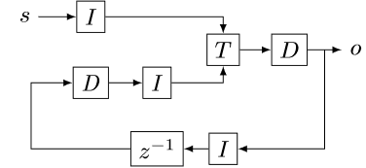
Proof of the cycle rule
$$⇔$$
$$⇔$$

Slide 108
Nested incremental computation
Let us consider $f:A→B$
If $A, B$ are scalar types, define $f^{Δ}=f$
Take $↑g:S_{A}→S_{B}$
Define recursively ${(↑g)}^{Δ}=D∘g^{Δ}∘I$
We have ${\left(↑↑f\right)}^{Δ}=D∘\left(↑D\right)∘(↑↑f)∘\left(↑I\right)∘I$
For a linear $f$ we still have ${\left(↑↑f\right)}^{Δ}=f$

Slide 109
Optimizing distinct
Distinct is idempotent: $distinct∘distinct=distinct$
For many relational queries Q the following two are equivalent ($Q$ one of select, project, join, map, flatmap, union, intersection)
For Q in join, product, filter, select we have

Slide 110
Incremental distinct

Slide 111
Optimality?
We take a query plan and generate an incremental plan from it
The incremental plan has the same “shape”
It only computes on changes
It does strictly less work if changes are assumed to be small
No one knows what optimality is for incremental plans
The optimal (non-incremental) plan depends on the data
The optima incremental plan would depend on all future changes!

Slide 112
Recursive query end-to-end example
input relation E(h: Node , t: Node )
output relation R(s: Node , t: Node ) R(x , x ) : - E (x , _ ). R(x , x ) : - E (_ , x ). R(x , y ) : - E (x , y ). R(x , y ) : - E (x , z), R(z , y ).

Slide 113
Recursive example: circuit
Non-recursive query
Recursive version

Slide 114
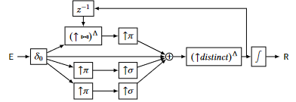
Recursive example: lifted and incremental
linearity

Slide 115
Recursive example: lifted and incrementalized

